Slide 1
Introductory Spanish
¿Qué haces todos los días?
Notes:
All text in these slides is taken from https://courses.lumenlearning.com/wm-spanish1/ where it is published under one or more open licenses.
All images in these slides are attributed in the notes of the slide on which they appear and licensed as indicated.

Slide 2
Manos a la obra

Slide 3
Learning Outcomes: Manos a la obra
13.1.1: Recognize vocabulary related to parts of the body
13.1.2: Understand spoken sentences related to parts of the body

Slide 4
Introduction to Manos a la obra
In this vocabulary section we’ll learn the parts of the body. As in many languages, a lot of Spanish idioms are formed with parts of the body.

Slide 5
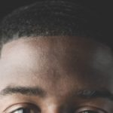
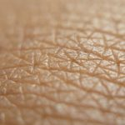
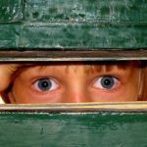
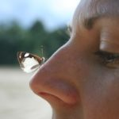
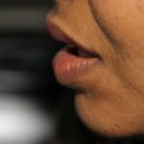
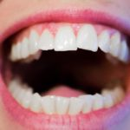
Vocabulario
La frente
La piel
Los ojos
La nariz
La boca
Los dientes
Notes:
Forehead. Located at: https://pxhere.com/en/photo/1412284. License: CC0: No Rights Reserved
La piel. Authored by: Tong Creator. Located at: https://pixabay.com/es/photos/la-piel-piel-morena-2016480/. License: Other. License Terms: Pixabay License: https://pixabay.com/es/service/license/
Eyes of a child in the letter hole. Authored by: Alex Grech. Located at: https://commons.wikimedia.org/wiki/File:Eyes_of_a_child_in_the_letter_hole.jpg. License: CC BY: Attribution
La boca. Located at: https://www.pxfuel.com/es/free-photo-oiovl. License: CC0: No Rights Reserved
Teeth. Authored by: Kjerstin Michaela. Located at: https://www.needpix.com/photo/729918/teeth-dentist-dental-mouth-white-hygiene-dentistry-smile-woman. License: CC0: No Rights Reserved

Slide 6
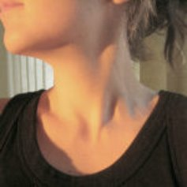
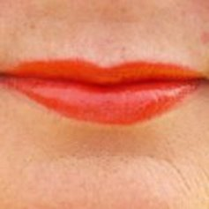
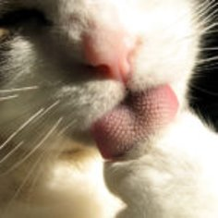
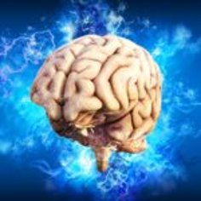
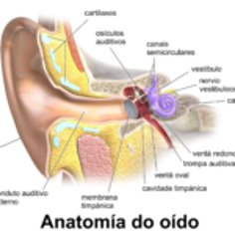
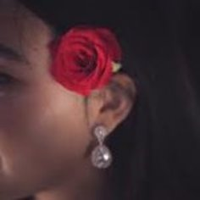
Vocabulario
El cuello
Los labios
La lengua
El cerebro
El oído
La oreja
Notes:
Lips. Authored by: Hans. Located at: https://pixabay.com/nl/photos/lippen-rood-gesmolten-gezicht-mond-64395/. License: Other. License Terms: Pixabay license
tongue. Authored by: torbakhopper. Located at: https://www.flickr.com/photos/gazeronly/392125657. License: CC BY: Attribution
ear anatomy. Authored by: BruceBlaus. Located at: https://commons.wikimedia.org/wiki/File:Blausen_0328_EarAnatomy_-_gl.png. License: CC BY: Attribution
ear. Located at: https://pxhere.com/es/photo/1527453. License: CC0: No Rights Reserved
Authored by: TheDigitalArtist. Located at: https://pixabay.com/es/illustrations/cerebro-pensamiento-mente-idea-4314636/. License: Other. License Terms: Pixabay license

Slide 7
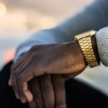
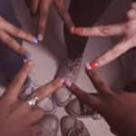
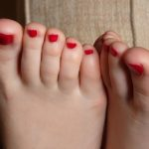
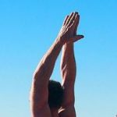
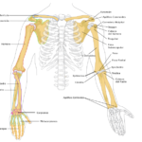
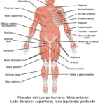
Vocabulario
Las manos
Los dedos (de las manos)
Los dedos de pie
Los brazos
Los huesos
Los músculos
Notes:
Las manos. Authored by: Segopotso Makhutja. Located at: https://www.pexels.com/es-es/foto/dorado-hombre-manos-mirar-1136589/. License: CC BY: Attribution
Toes . Authored by: sole_lover. Located at: https://commons.wikimedia.org/wiki/File:Toes_feet_1.jpg. License: CC0: No Rights Reserved
Arms. Authored by: Lilian White. Located at: https://commons.wikimedia.org/wiki/File:Rocket-yoga-01-4000px.jpg. License: CC BY:
Huesos del miembro superior. Authored by: Torax. Located at: https://es.wikipedia.org/wiki/Archivo:Huesos_del_miembro_superior.svg. License: CC BY-SA: Attribution-ShareAlike
Anterior and Posterior Views of Muscles. Authored by: OpenStax. Located at: https://es.wikipedia.org/wiki/Archivo:1105_Anterior_and_Posterior_Views_of_Muscles_esp.jpg. License: CC BY-SA: Attribution-ShareAlike

Slide 8
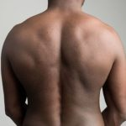
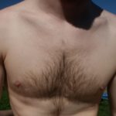

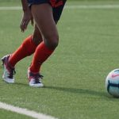
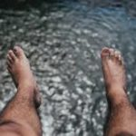
Vocabulario
La espalda
El pecho
El estómago
Las piernas
Los pies
Notes:
Feet. Authored by: Kaique Rocha. Located at: https://www.pexels.com/es-es/foto/agua-al-aire-libre-colgando-dedos-de-los-pies-57646/. License: CC BY: Attribution
Authored by: mohamed mahmoud hassan. Located at: https://www.publicdomainpictures.net/es/view-image.php?image=261441&picture=dolor-de-estomago. License: CC0: No Rights Reserved
Human back on gray background. Authored by: Genusfotografen. Located at: https://commons.wikimedia.org/wiki/File:Human_back_on_gray_background.jpg. License: CC BY-SA: Attribution-ShareAlike
Chest. Authored by: Matt Baume. Located at: https://www.flickr.com/photos/mattymatt/423814919. License: CC BY-SA: Attribution-ShareAlike
Las piernas. Located at: https://p0.piqsels.com/preview/533/876/42/woman-in-red-jersey-kicking-the-ball.jpg. License: CC0: No Rights Reserved

Slide 9



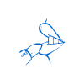


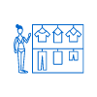

Vocabulario
Afeitarse
Peinarse
Cepillarse los dientes
Maquillarse
Sentarse
Cepillarse el pelo
Vestirse (e>i)
Acostarse (o>ue)
Notes:
Icons. Provided by: The Noun Project. License: CC BY: Attribution. License Terms: Noun Pro License

Slide 10






Vocabulario
Levantarse
Despertarse
Ducharse
Bañarse
Limpiarse
Lavarse
Notes:
Icons. Provided by: The Noun Project. License: CC BY: Attribution. License Terms: Noun Pro License

Slide 11
Ejercicios
Tacha la palabra que no pertenece al grupo, y explica por qué no pertenece.
Lengua – Estómago – Espalda – Pecho
Brazos – Dedos – Manos – Dientes
Pie – Lengua – Boca – Labios
Huesos – Músculos – Pierna – Piel
Acostarse – Despertarse – Levantarse – Limpiarse
Peinarse – Maquillarse – Vestirse – Sentarse

Slide 12
Actividad: Hace frío y luego calor
Ahora que hay un cambio de clima, un día hace frío y el otro hace calor. ¿Qué ropa necesitas para el frío? ¿Qué ropa necesitas para el calor? Haz una lista de la ropa necesaria para cada parte del cuerpo.
 | para el frío | para el calor
el pecho
las piernas
los pies
las manos
la cabeza
el cuello

Slide 13
Actividad: ¿Cuándo sí y cuándo no?
Trabaja con un compañero y explica cuándo una persona tiene que hacer las siguientes actividades y cuándo no tiene que hacerlas.
Modelo: Afeitarse la barba Estudiante 1: ¿Cuándo tiene que afeitarse la barba? Estudiante 2: Tiene que afeitarse la barba cuando tiene una entrevista. Estudiante 3: No tiene que afeitarse la barba en noviembre.
Vestirse con ropa elegante
Acostarse temprano
Maquillarse
Cepillar el pelo del perro
Bañarse en la bañera

Slide 14
Practice Question 1
Which of the following words doesn't belong in the group?
Afeitarse
Maquillarse
Acostarse
Cepillarse los dientes
Notes:
Answer is C

Slide 15
Practice Question 2
Which of the following words doesn't belong in the group?
Las piernas
La oreja
Los ojos
La boca
Notes:
Answer is A

Slide 16
Quick Review
What words are used to describe parts of the body?
What verbs do we use to talk about things we do?

