Slide 1
Principles of Marketing
Module 15: Marketing Plan
Notes:
All text in these slides is taken from https://courses.lumenlearning.com/wmopen-principlesofmarketing/, where it is published under one or more open licenses.
All images in these slides are attributed in the notes of the slide on which they appear and licensed as indicated.
Cover Image: "Shopping freak." Provided by: freestocks.org. Located at: https://unsplash.com/photos/_3Q3tsJ01nc. Content Type: CC Licensed Content, Shared Previously. License: CC0: No Rights Reserved.

Slide 2

Elements of a Marketing Plan
Notes:
Imagine Cup 2012 - Day 4 Finalist Presentations. Provided by: ImagineCup. Located at: https://www.flickr.com/photos/imaginecup/7534287902/. License: CC BY: Attribution

Slide 3
1. Executive Summary
What is this plan about?
Summary of key points from the marketing plan and what it will accomplish
An at-a-glance overview for a manager who may not have time to look over the whole thing
Note: This may be the most important part. It can often be wise to write it last, but not at the last minute

Slide 4
2. Company Profile
What organization are you marketing?
Basic information about the organization, its offerings, and competitive set

Slide 5
3. Market Segmentation and Targeting
Who is your target audience?
Description of the market for the product or service in question, segments in this market, and targeting strategy the marketing plan will address

Slide 6
4. Situation and Company Analysis
What is your strategy, and why is it the right approach?
SWOT analysis of the external marketing environment and the internal company environment, and marketing goals aligned with the company mission and objectives

Slide 7
5. Ethics and Social Responsibility
How will you demonstrate good corporate citizenship?
Recommendations for how to address any issues around ethics, social responsibility, and sustainability

Slide 8
6. Marketing Information and Research
What information do you need to be successful, and how will you get it?
Discussion of key questions that need to be answered, the information needed, and recommendations for how marketing research can provide answers

Slide 9
7. Customer Decision-Making Profile
Who is your target customer, and what influences their buying decisions?
Profile of the primary buyer(s) targeted in the marketing plan and factors that impact their choices

Slide 10
8. Positioning and Differentiation
What do you want to be known for?
List of competitive advantages, positioning recommendations, and how to convince the market you are different and better

Slide 11
9. Branding
What is the brand you are building?
Brand platform describing the brand: promise, voice, personality, positioning, and strategic recommendations for building the brand

Slide 12
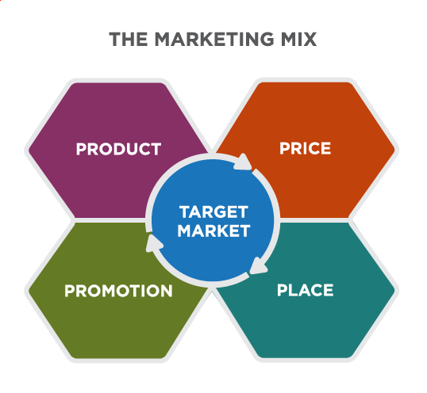
10. Marketing Mix
How will you impact your target market?
This question is addressed by the strategic recommendations around each of the four Ps below

Slide 13
Marketing Mix: Product Strategy
What are you offering to your target market?
Description of the product or service being marketed and recommended improvements to fit the needs of target segments

Slide 14
Marketing Mix: Pricing Strategy
How are you pricing the offering?
Recommendations on pricing strategy and why this approach makes sense

Slide 15
Marketing Mix: Place – Distribution Strategy
How are you distributing the offering?
Recommendations on distribution strategy and channel partners to improve the availability of your offering, and explanations of why this approach makes sense

Slide 16
Marketing Mix: Promotion – IMC Strategy
What marketing campaign(s) are you running?
Overview of marketing strategy, objectives, messaging, and tactical approach for marketing campaign(s) to reach your target audiences

Slide 17
11. Measurement and KPIs
How will you measure the impact you’re making?
Identification of key performance indicators (KPIs) and other metrics to monitor effectiveness of marketing campaign activities and provide clues about when to adjust course.

Slide 18
12. Budget
How much will this cost?
List of resources required to execute the marketing plan, how much they will cost, and how to stay within the allocated budget

Slide 19
13. Action Plan
What will it take to make this happen?
A detailed, step-by-step plan about what needs to happen, when, and who’s responsible for each step to execute the marketing campaign.

Slide 20
14. Risk Factors
What are the risks of this approach?
Discussion of any significant risks or threats associated with this plan and contingency plans for addressing them

Slide 21
Advice for Presenting the
Marketing Plan
Consider your audience
Power-point, google sites, or prezi may be effective tools
Notes:
Sneaky Beb. Authored by: Bitey Mad Lady. Located at: https://www.flickr.com/photos/froggenstein/16911480062/. License: CC BY-NC-ND: Attribution-NonCommercial-NoDerivatives

Slide 22

PowerPoint Tips
Don’t choose a font that is too small
Don’t put too many works on a slide
Watch out for spelling errors
Don’t choose distracting colors that make it hard to read the information
Make sure to select images that clearly align with content
Notes:
Sneaky Beb. Authored by: Bitey Mad Lady. Located at: https://www.flickr.com/photos/froggenstein/16911480062/. License: CC BY-NC-ND: Attribution-NonCommercial-NoDerivatives

Slide 23
Practice Question
What rule of effective power-point presentations did the last slide break?
Notes:
The cat didn’t have anything to do with the topic.

Slide 24
Prepare for your Presentation
Practice! Take what you’ve learned about SWOT and do a SWOT analysis of your presentation
Be confident. You’re the person who knows the most about your plan
Ask a friend or family member to watch you present. Request that they be honest with you and give constructive criticism
Talk to your audience, not to the screen. Your audience can read the slides, so use your voice to explain more of the details

Slide 25
A Good Business Presentation
Should drive action
Is short and focused
Begins with recommendations and supports them
Is an opportunity to learn and collaborate

Slide 26
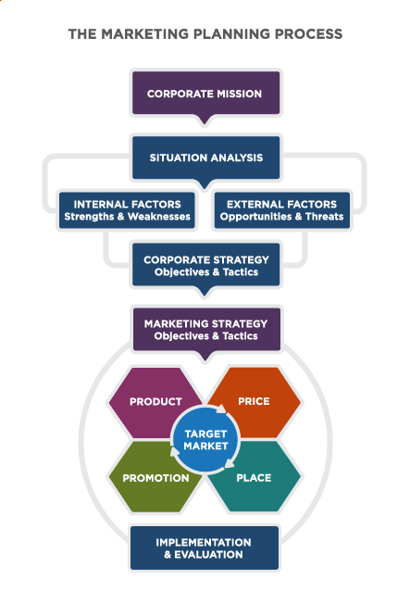
Implementing the Marketing Plan
The marketing plan should aid communication within the marketing function and other functions to check for alignment and ensure the action plan is clear
Notes:
Reading: Using and Updating the Marketing Plan. Provided by: Lumen Learning. License: CC BY: Attribution

Slide 27
Adjusting the Plan
As soon as the first activity identified in the plan is executed, the marketing plan begins to be outdated
Each action will generate new market data about what works that should shape the rest of the plan and its implementation

Slide 28
Quick Review
What are the key elements of the marketing plan
How can marketing plans be presented most effectively?
How is the marketing plan used by marketing teams and the overall organization?

