Slide 1
Principles of Marketing
Module 13: Promotion
Notes:
All text in these slides is taken from https://courses.lumenlearning.com/wmopen-principlesofmarketing/, where it is published under one or more open licenses.
All images in these slides are attributed in the notes of the slide on which they appear and licensed as indicated.
Cover Image: "Shopping freak." Provided by: freestocks.org. Located at: https://unsplash.com/photos/_3Q3tsJ01nc. Content Type: CC Licensed Content, Shared Previously. License: CC0: No Rights Reserved.

Slide 2
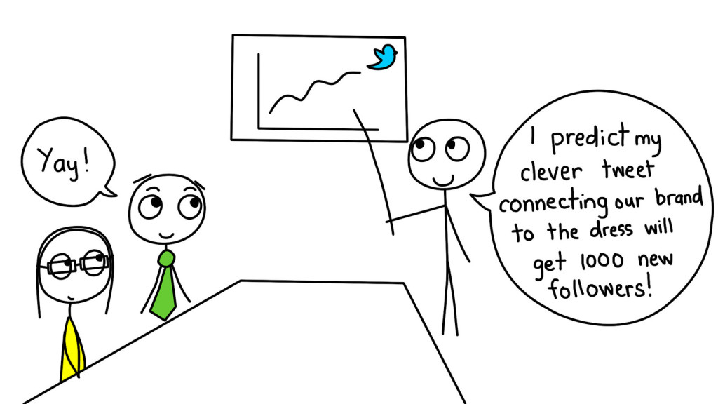
The Promotion Mix
There are many different marketing communication methods that can be used in the promotion mix.
Notes:
People On Internet Argue About Dress Colour. Authored by: studio tdes. Located at: https://www.flickr.com/photos/thedailyenglishshow/16725299326/. License: CC BY: Attribution

Slide 3
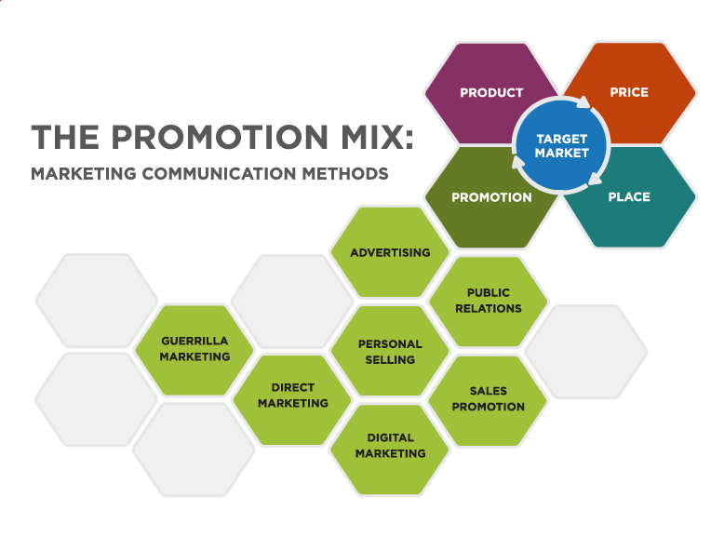
The Promotion Mix 2

Slide 4
Channel Structures
While channels can be very complex, there is a set of channel structures that can be identified in most transactions:
Direct channel
Retail channel
Wholesale channel
Agent channel

Slide 5
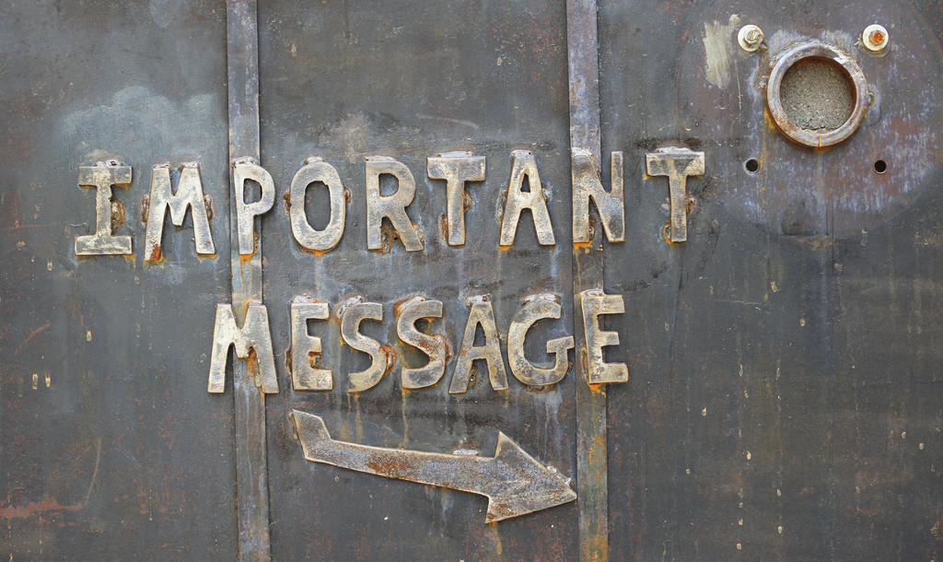
Key Message Should:
Express the main idea you want people to understand and remember about your offering
Resonate with the audience you are targeting
Articulate clearly and concisely what you need to communicate about
Notes:
Important Message. Authored by: Patrick Denker. Located at: https://www.flickr.com/photos/pdenker/6001236724/. License: CC BY: Attribution

Slide 6
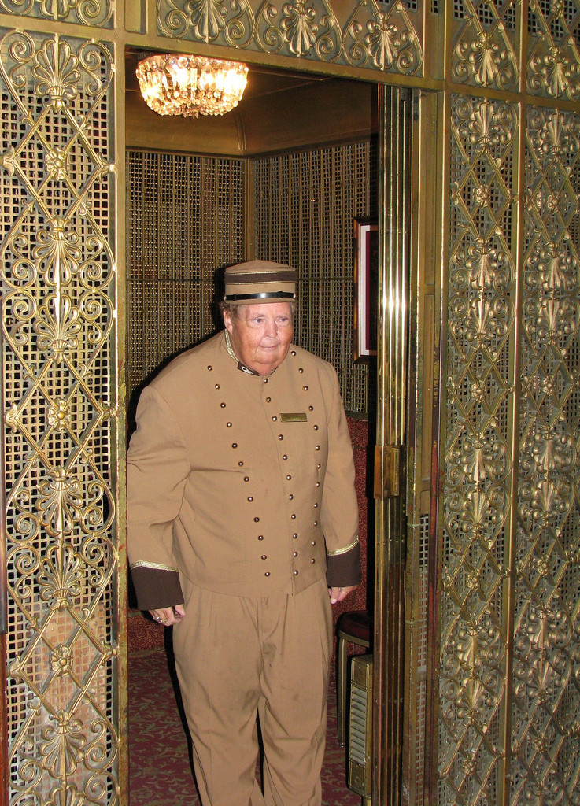
Traits of Good Key Messages:
Concise
Simple
Strategic
Convincing
Relevant
Memorable
Tailored
Notes:
Elevator Operator. Authored by: Rennett Stowe. Located at: https://www.flickr.com/photos/tomsaint/2705065854/. License: CC BY-NC-ND: Attribution-NonCommercial-NoDerivatives

Slide 7
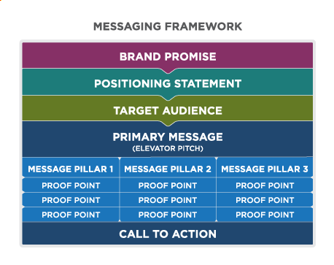
Messaging Framework
Notes:
Reading: Defining the Message. Authored by: Lumen Learning. License: CC BY: Attribution

Slide 8
Refine Your Message
Alignment
Hearts and Minds
Strategy
Differentiation
Tone
Clarity
Inspiration

Slide 9
Example: HighFive’s Messaging
Brand Promise: Video conferencing you can actually love
Positioning Statement: Highfive is the first video conferencing product designed to connect every employee and every conference room in your entire company
Target Audience: 1, C-level Executive (influencer); 2, Director of IT (buyer); and 3, End-user (user)
Mission: Our mission is to make every conversation face-to-face
Tone of Voice: Empowering, progressive, human, and cheeky
Notes:
Source: “How to Create Brand Messaging That Really Resonates.” Salesforce Pardot https://www.pardot.com/blog/how-to-create-brand-messaging-that-really-resonates/

Slide 10
Example continued: HighFive Elevator Pitch
Elevator Pitch: Highfive is video conferencing you can actually love. We believe teams work best face-to-face. That’s why we designed the first video conferencing product designed to connect every person and room in an organization. Highfive provides an all-in-one video conferencing hardware device that plugs into any TV screen, turning any ordinary meeting room into a video room. Highfive also provides cloud apps, which allow employees and guests to simply click a link from any laptop or mobile device and instantly connect face-to-face with anyone, anywhere. The hardware device costs the same as a high-end iPad and the cloud apps are free. We think video shouldn’t be a boardroom luxury. It should be available everywhere.

Slide 11
Example continued: HighFive Brand Pillars
Brand Pillars
  Easy
    Headline benefits: Highfive is beautifully simple video conferencing you can start or join with a single click.
    Supporting examples: Join calls from your calendar, SMS, or email by clicking a URL, hand off video calls from your personal device to a meeting room TV with a swipe or click—no remote control needed. 5-minute plug and play setup.
  Everywhere
    Headline Benefits: Twenty conference rooms for the price of one Cisco or Polycom system.
    Supporting Examples: Comparable systems cost, about 15 thousand per room. At the price of an iPad, Highfive can be deployed in every room. Free apps let people stay connected at their desks or on the go.
  Enterprise
    Headline Benefits: Built for businesses, not social networking.
    Supporting Examples: Must sign up with work email address, domain-based security model, enterprise reliability and security built by the same people that built Google Apps for Business.

Slide 12
Standard Marketing Campaign Planning Steps:
Determine the target market
Determine purpose and objectives for the IMC campaign
Set S.M.A.R.T. goals
Define the message
Select marketing communications methods and tools
Determine the promotional mix: which tools to use, when, and how much
Execute the campaign
Measure results and refine approach, as needed

Slide 13
The AIDA Model
A represents attention or awareness, and the ability to attract the attention of the consumers
I is interest and points to the ability to raise the interest of consumers by focusing on and demonstrating advantages and benefits (instead of focusing on features, as in traditional advertising)
D represents desire. The advertisement convinces consumers that they want and desire the product or service because it will satisfy their needs
A is action. Consumers are led to take action by purchasing the product or service

Slide 14
Campaign Objectives and AIDA Model Stages
AIDA Model Stages | Typical Campaign Objectives
Awareness: Build awareness to motivate further action | Develop brand awareness and recognition Increase traffic to physical or virtual stores, Web sites, or other channels Remind customers about a brand, product, service or category
Interest: Generate interest by informing about benefits; shaping perceptions | Differentiate a product, stressing benefits and features not available from competitors Provide more information about the product or the service because information may be correlated with greater likelihood of purchase Increase demand for a specific product or a product category; generate enough interest to research further
Desire: Create desire; move from “liking” to “wanting” | Build brand equity by increasing customer perceptions of quality, desirability, and other brand attributes Stimulate trial, an important step in building new brands and rejuvenating stagnant brands Change or influence customer beliefs and attitudes about a brand, product, or category, ideally creating an emotional connection
Action: Take action toward purchasing | Reduce purchase risk to make prospective customers feel more comfortable buying a new or unfamiliar product or brand Encourage repeat purchases in the effort to increase usage and brand loyalty Increase sales and/or market share, with the goal of broadening reach within a time period, product category, or segment
Notes:
Revision and adaptation. Provided by: Lumen Learning. License: CC BY-SA: Attribution-ShareAlike

Slide 15
Push Strategy
A push strategy places the product in front of the customer, to make sure the consumer is aware of the existence of the product
Push strategies also create incentives for retailers to stock products and put them in front of the customer.
Point-of-sale displays that make a product highly visible to consumers
Retailer incentives to stock and sell products, such as discounted bulk pricing

Slide 16
Pull Strategy
A pull strategy stimulates demand and motivates customers to actively seek out a specific product.
Aimed primarily at the end users, rather than retailers or other middle players in the value chain
Pull strategies can be particularly successful for strong, visible brands with which consumers already have some familiarity
Examples:
Mass-media advertising and promotion of a product
Marketing communications with existing customers to make them aware of new products that will fill a specific need
Referrals and word-of-mouth recommendations from existing customers

Slide 17
Engagement Strategies
Campaign Strategies
Corresponding Well-suited IMC Tactics, Tools
Interact
Engage
Embrace
Influence
Convince
Educate
Inspire
Nurture
Social media, events, guerilla marketing efforts
Word-of-mouth recommendations, viral sharing, social media
Brand community, social media, events, sales, promotions, viral sharing
Public relations, thought leadership activities, personal selling
Case studies, testimonials, comparisons, free trials, samples
Advertising, thought leadership activities, public relations, website and other content making
Testimonials, guerilla marketing, events, advertising, case studies
Email marketing, content marketing, personal selling.
Notes:
Revision and adaptation. Provided by: Lumen Learning. License: CC BY-SA: Attribution-ShareAlike

Slide 18
SMART Goals
Specific: target a specific area for improvement
Measurable: quantify or at least suggest an indicator of progress
Assignable: specify who will do it
Realistic: state what results can realistically be achieved, given available resources
Time-related: specify when the result(s) can be achieved

Slide 19
Call to Action
Each touch point should include a call to action aligned with the campaign strategy and goals.

Slide 20
Considerations in Selecting Marketing Communication Methods
Budget: What is the budget for the marketing campaign, and what resources are available to execute it?
Timing: Some IMC methods and tactics require a longer lead time than others
Audience: Effective IMC methods meet audiences where they are
Existing assets and organizational strength

Slide 21
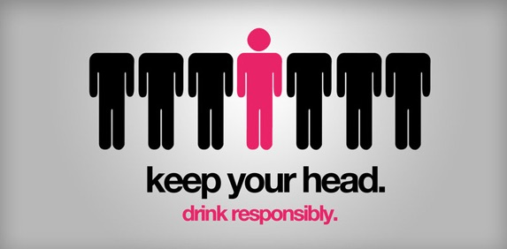
Advertising
Advertising is any paid form of communication from an identified sponsor or source that draws attention to ideas, goods, services or the sponsor itself
Advertising has three primary objectives: to inform, to persuade, and to remind
Notes:
Screenshot Keep Your Head PSA. Provided by: Lumen Learning. License: CC BY: Attribution

Slide 22

Public Relations
Public relations (PR) is the process of maintaining a favorable image and building beneficial relationships between an organization and the public communities, groups, and people it serves
Unlike advertising, public relations does not pay for attention and publicity.
Notes:
Screenshot Public Relationsu2014LeMaster Group. Provided by: Lumen Learning. License: CC BY: Attribution

Slide 23
Public Relations Techniques
Public Relations Technique
Corresponding Role and Description
Media Relations
Influencer / Analyst Relations
Publications and Thought Leadership
Events
Sponsorships
Award Programs
Crisis Management
Generate positive news coverage about the organization, its products, services, people, and activities
Maintain strong, beneficial relationships with individuals who are thought leaders for a market or segment
Provide information about the organization, showcase its expertise and competitive advantages
Engage with a community to present information and an interactive “live” experience with a product, service, organization or brand
Raise the profile of an organization by affiliating it with specific causes or activities
Generate recognition for excellence within the organization and/or among customers
Manage perceptions and contain concerns in the face of an emergency situation

Slide 24

Personal Selling
Personal selling uses in-person interaction to sell products and services. This type of communication is carried out by sales representatives, who are the personal connection between a buyer and a company or a company’s products or services.
Notes:
Phone call. Provided by: CWCS Managed Hosting. Located at: https://www.flickr.com/photos/122969584@N07/13780153345/. License: CC BY: Attribution

Slide 25
Sales Promotion
Consumer Sales Promotions | B2B Sales Promotions
Coupons | Trade shows and conventions
Sweepstakes or contests | Sales contests
Premiums | Trade and advertising allowances
Rebates | Product demonstrations
Samples | Training
Loyalty programs | Free merchandise
Point-of-purchase displays | Push money

Slide 26
Digital Marketing
Digital marketing is an umbrella term for using a digital tools to promote and market products, services, organizations and brands. Email and mobile marketing overlaps with direct marketing. Other essential tools in the digital marketing tool kit: Web sites, content marketing and search-engine optimization (SEO), and social media marketing.

Slide 27

Direct Marketing
Direct marketing activities bypass intermediaries and communicate directly with the individual consumer. Direct marketing can be a powerful tool for anticipating and predicting customer needs and behaviors. Over time, as companies use consumer data to understand their target audiences and market dynamics, they can develop more effective campaigns and offers. Among the leading disadvantages of direct marketing are concerns about privacy and information security.

Slide 28
Direct Marketing (continued)
Direct marketing activities bypass intermediaries and communicate directly with the individual consumer
Direct marketing can be a powerful tool for anticipating and predicting customer needs and behaviors
Over time, as companies use consumer data to understand their target audiences and market dynamics, they can develop more effective campaigns and offers
The disadvantage of direct marketing are concerns about privacy and information security

Slide 29
Social Media Marketing
Social media marketing is the use of online applications, networks, blogs, wikis, and other collaborative media for communicating brand messaging, conducting marketing, public relations, and lead generation
The three main objectives are:
Creating buzz
Fostering community
Facilitating two-way communication

Slide 30
Social Media Tools
Blogs: Long- or short-form medium for communicating with audiences
YouTube: Video-hosting social media site
Twitter: Short-form (140 character) “microblogging” medium that is intended for text and image sharing
Facebook: Long-form (up to 2,000 characters per post) medium for sharing text, images, videos, and other multimedia content
Instagram: Image-based social network that is intended as a visual medium. Does not have capabilities to drive click-through rate (CTR) because posts offer no link option
Notes:
Digital Marketing. Provided by: Lumen Learning. Located at: https://courses.lumenlearning.com/waymakerintromarketingxmasterfall2016/chapter/reading-digital-marketing/. License: CC BY: Attribution

Slide 31
Social Media Tools (continued)
Google+: Long-form medium for sharing text, images, videos, and other multimedia content
Pinterest: Medium for sharing photos and visual content categorized by theme
LinkedIn: Long- or short-form medium for sharing text, images, videos, and other multimedia content targeted to the business community
Notes:
Digital Marketing. Provided by: Lumen Learning. Located at: https://courses.lumenlearning.com/waymakerintromarketingxmasterfall2016/chapter/reading-digital-marketing/. License: CC BY: Attribution

Slide 32
Guerrilla Marketing
Guerrilla marketing is a relatively new marketing strategy that relies on unconventional, often low-cost tactics to create awareness of and goodwill toward a brand, product, service, or even a company

Slide 33
Guerilla Marketing Tactics
Graffiti: Graffiti marketing, a subset of guerrilla marketing, turns walls, alleys, and streets into larger-than-life canvases for marketing activity.
Stencil graffiti: Use of stencils to create repeated works of graffiti, with the stencils enabling the project team to rapidly recreate the same work in multiple locations. Stencils tend to be smaller-scale and simpler than classic graffiti art.
Undercover, or stealth marketing: Use of marketers or paid actors to go “undercover” among peers to engage unsuspecting people in a marketing activity of some sort. For example, attractive actors are paid to strike up conversations, rave about a new mobile device, and then ask people to take a photo using the device, so that they get hands-on experience with the product in question.

Slide 34
Guerilla Marketing Tactics (Continued)
Stickers: Inventive use of stickers as a temporary medium for creating an image, posing an illusion, or conveying a message
Flash mobs: A group of people organized to perform an action at a predetermined place and time; usually they blend in with bystanders initially and then join the “mob” activity at the designated moment, as in the Do Re Mi video, above.
Publicity stunts: Extraordinary feats to attract the attention of the general public, as well as media
Treasure hunts: Staging an activity or event that appears real, but in fact is a fake, for the purposes of drawing attention and making a statement
Sham events: Staging an activity or event that appears real, but in fact is a fake, for the purposes of drawing attention and making a statement

Slide 35
Tools of Marketing and AIDA Stages
Advertising is particularly well-suited to awareness-building
Public relations activities often focus on generate interest, educating prospective customers and sharing stories that create desire for a product or brand. Similarly, experiential events can create memorable opportunities to interact with product, brands and people.
Personal selling typically focuses at the later stages of the model, solidifying desire and stimulating action
Tools for any stage of AIDA: Sales promotions, Direct marketing, Digital marketing, Guerrilla marketing

Slide 36
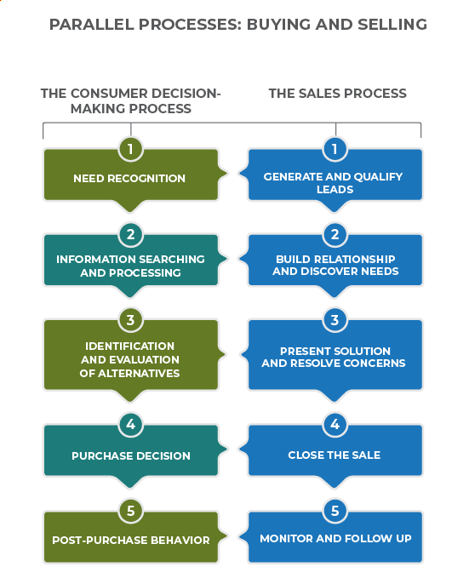
The Sales Process
Notes:
Reading: Using IMC in the Sales Process. Provided by: Lumen Learning. License: CC BY: Attribution

Slide 37
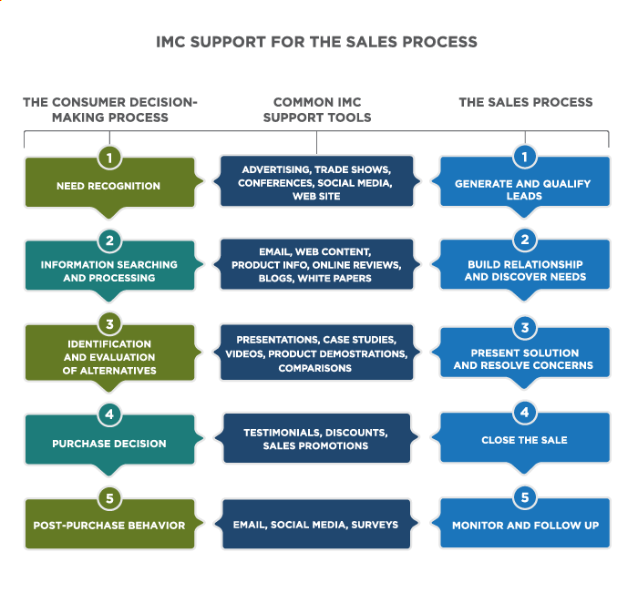
IMC Support for the Sales Process
Notes:
Reading: Using IMC in the Sales Process. Provided by: Lumen Learning. License: CC BY: Attribution

Slide 38
Goals of CRM Systems
capture new leads and move them through the sales process
support and manage relationships with current customers to maximize their lifetime value to the company
boost productivity and lower the overall costs of marketing, sales, and account management

Slide 39
The Power of CRM
CRM systems are transformational for marketing communication because they allow marketers to use customer data to personalize their interactions to fit the unique needs of individuals

Slide 40
Key Performance Indicators
A KPI is something measurable that indicates the progress an organization is making toward its business objectives
They can be determined for each level of the organization: company, department, team, campaign, marketing tactic
Must be aligned to business objectives

Slide 41
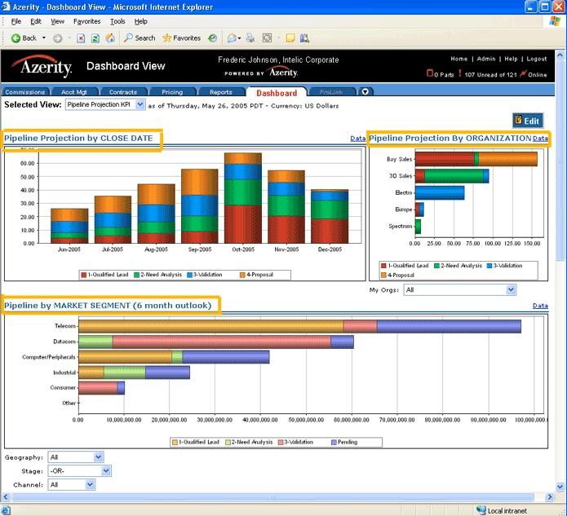
Monitoring KPIs: KPI Dashboard Example
Notes:
Reading: Measuring Marketing Communication Effectiveness. Authored by: Lumen Learning. License: CC BY: Attribution

Slide 42
Some Examples of Business Objectives and Related KPIs
Market Share
    Market share in category
    Relative market share (share relative to largest competitors)
Lead Generation
    Number of qualified leads
    Cost per lead (by source/platform)
    Traffic source breakdown
Build Brand
    Brand awareness
    Brand equity
    Price premium
    Brand valuation
    Share of voice: mentions of your brand/mentions of others
    Brand community membership
Notes:
Examples of Key Performance Indicators. Authored by: Melissa Barker. Provided by: Spokane Falls Community College. License: CC BY: Attribution

Slide 43
Campaign Plan Components
Promotional mix
Resource and budget requirements
Timing
Ownership
Measurement

Slide 44
Example: Promotional Mix Budget Template
Promotional Mix Elements
  10% Direct Marketing: email campaigns – $500 Allocated
  10% Digital marketing: Web-site messaging update; contest pages, social media – $500 Allocated
  25% Advertising: sidewalk sandwich boards, localized digital ads in Facebook – $1,250 Allocated
  45% Sales promotion: coupons, create-a-flavor contest, sidewalk samples, in-store posters – $2,250 Allocated
  10%: Public relations: press releases – $500 Allocated
  Total Budget Allocated – $5,000
Notes:
Reading: Developing a Communication Plan. Authored by: Lumen Learning. License: CC BY: Attribution

Slide 45
Example: Budget-Detail Template (Table)
Item | Purpose | Cost Estimate
Email-campaign template | Direct marketing: professional design for standard email template for use in multiple campaigns | $500
Web-site contest pages, internal ads | Digital marketing: professional design for Web pages and forms for create-a-flavor contest, sidewalk tasting events, internal site “ads” for contest | $500
Ad design work | Advertising: designer work for sandwich boards, online ads | $250
Facebook ads | Facebook ads targeting local areas | $650
Sandwich boards | Advertising: three sandwich boards for display outside shops | $350
Coupons, contest fliers, in-store posters | Sales promotion: design and production to match other campaign-related materials | $400
Coupon value | Sales promotion: estimated cost of redeemed coupons | $350
Sidewalk sample cost-of-goods | Sales promotion: cost of ingredients, materials, extra labor for executing sidewalk tasting events | $1,500
Press releases | PR firm assistance with press release writing, local distribution | $500
Internal labor | Employee labor to execute campaign | 25% FTE
Total | All costs excluding employee labor | $5,000
Notes:
Reading: Developing a Communication Plan. Authored by: Lumen Learning. License: CC BY: Attribution

Slide 46
Example: Budget-Detail Template List
Item, purpose, and cost estimate
Email-campaign template: Direct marketing: professional design for standard email template for use in multiple campaigns: Estimated Cost $500
Web-site contest pages, internal ads: Digital marketing: professional design for Web pages and forms for create-a-flavor contest, sidewalk tasting events, internal site “ads” for contest: Estimated Cost $500
Ad design work: Advertising: designer work for sandwich boards, online ads: Estimated Cost $250
Facebook ads: Facebook ads targeting local areas: Estimated Cost $650
Sandwich boards: Advertising: three sandwich boards for display outside shops: Estimated Cost $350
Notes:
Reading: Developing a Communication Plan. Authored by: Lumen Learning. License: CC BY: Attribution
The information on this slide and on the following slide are a repeat of the information presented on the slide “Example: Budget-Detail Template Table”, just in list form.

Slide 47
Example: Budget-Detail Template List (continued)
Item, purpose, and cost estimate
Coupons, contest fliers, in-store posters: Sales promotion: design and production to match other campaign-related materials: Estimated Cost $400
Coupon value: Sales promotion: estimated cost of redeemed coupons: Estimated Cost $350
Sidewalk sample cost-of-goods: Sales promotion: cost of ingredients, materials, extra labor for executing sidewalk tasting events: Estimated Cost $1,500
Press releases: PR firm assistance with press release writing, local distribution: Estimated Cost $500
Internal labor: Employee labor to execute campaign: Estimated Cost 25% FTE
Total: All costs excluding employee labor $5,000
Notes:
Reading: Developing a Communication Plan. Authored by: Lumen Learning. License: CC BY: Attribution
The information on this slide and on the previous slide are a repeat of the information presented on the slide “Example: Budget-Detail Template Table”, just in list form.

Slide 48
Example: Campaign Action Plan Template (Table)
Timing | Activity Type | Brief Description | Audience | Owner
3 March | Designer creative brief | Draft a creative brief outlining all campaign elements we want designer to complete | Designer | Martina Hagen
28 March | Design work complete | Approve email template, Web-site updates, digital ads, sandwich boards, posters, coupons, fliers | Local public, families, foodies | Designer with Martina
5 April | Production of print materials | Complete production of posters, sandwich boards, coupons, fliers | Local public, families, foodies | Martina Hagen
6 April | Employee briefing | Conduct campaign-information sessions with employees; share campaign materials, go through frequently asked questions | Employees | Martina Hagen with store managers
7 April | Campaign launch: in-store | Prepare in-store display for campaign: posters, fliers, coupons, contest information | Store customer | Store managers
7 April | Campaign launch: digital | Activate and test website updates and campaign pages/forms; send targeted campaign email messages about contest and sidewalk tasting events | Store “friends” email list; purchased residential email list | Martina Hagen
Notes:
Reading: Developing a Communication Plan. Authored by: Lumen Learning. License: CC BY: Attribution

Slide 49
Example: Campaign Action Plan Template List
Timing, Activity Type, Brief Description, Audience and Owner
March 3, Designer creative brief: Draft a creative brief outlining all campaign elements we want designer to complete: Audience is Designer, Owner is Martina Hagen
March 28, Design work complete: Approve email template, Web-site updates, digital ads, sandwich boards, posters, coupons, fliers: Audience, Local public, families, foodies: Owner Designer with Martina
April 5, Production of print materials: Complete production of posters, sandwich boards, coupons, fliers: Audience, Local public, families, foodies: Owner Martina Hagen
April 6, Employee Briefing: Conduct campaign-information sessions with employees; share campaign materials, go through frequently asked questions: Audience is employees: Owner is Martina Hagen with store managers
Notes:
Reading: Developing a Communication Plan. Authored by: Lumen Learning. License: CC BY: Attribution
The information on this slide is a sample of the information presented on the slide “Campaign Action Plan Template Table”, just in list form.

Slide 50
Anticipate Risks and Threats
People: Can you count on key individuals?
Technology: Will technology work effectively?
Funding: Is there enough money to support the campaign? How can the campaign stay on budget?
Innovation: Anything new and untested represents risk
Competition: How might competitors gain advantages over, attack, or undermine your business?
Economy: What if an economic downturn creates uncertainty and lower spending?
Communication: How can you inform stakeholders and coordinate the campaign?
“Acts of God”: What will you do in case of a natural disaster?
Weaknesses from organization’s SWOT Analysis

Slide 51

Create Contingency Plans
Which threats are significant?
Create contingency plans for anything that is of particular concern
Notes:
Raining Cats and Dogs. Authored by: David Blackwell. Located at: https://www.flickr.com/photos/mobilestreetlife/12505752913/. License: CC BY-ND: Attribution-NoDerivatives

Slide 52
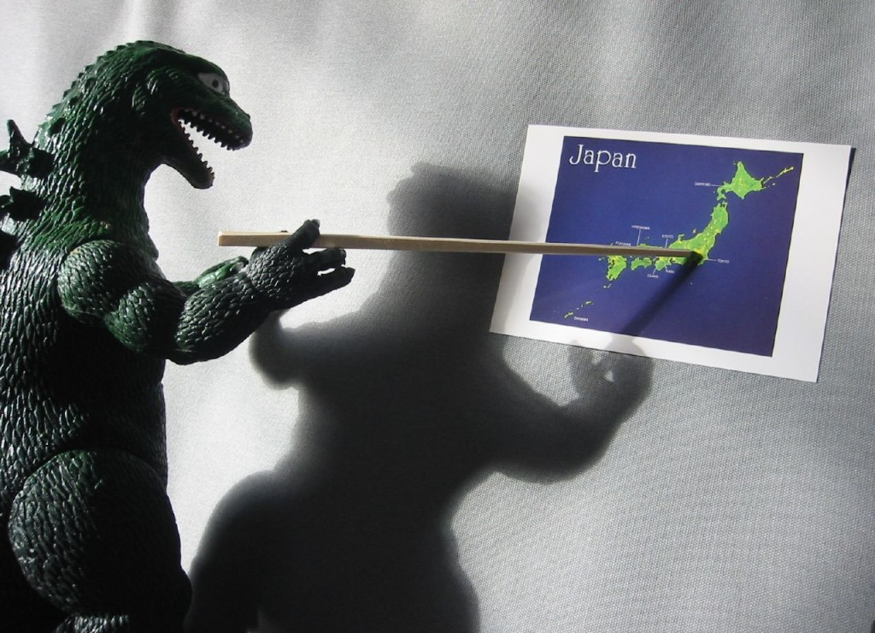
Practice Question
Why is it important to make a plan for a marketing campaign?
Notes:
Marketing campaigns need to be aligned to the company strategy. All the components of the campaign also need to be aligned within the campaign. People need to know what they are responsible for and when. Planning is needed to ensure that parts of the marketing mix with more lead time ie. Magazine ads can happen and that promotions don’t cost the company too much. It also helps to plan for contingencies.
Planning Session. Provided by: WorldIslandInfo.com. Located at: https://www.flickr.com/photos/76074333@N00/317952268/. License: CC BY: Attribution

Slide 53
Quick Review
What is integrated marketing communication (IMC) how does it connect to the organization’s marketing strategy?
How do organizations develop effective messaging for marketing communications?
What factors should you consider when selecting marketing communication methods to execute the strategy?
What are common methods of marketing communication, their advantages and disadvantages?
How do IMC tools support the sales process?
How are Customer Relationship Management (CRM) systems used for marketing communication purposes?
What common tools and approaches are used to measure marketing communication effectiveness?
How do marketers create a marketing campaign and budget using multiple IMC tools to execute a marketing strategy?

