Slide 1
Principles of Marketing
Module 12: Place: Distribution Channels
Notes:
All text in these slides is taken from https://courses.lumenlearning.com/wmopen-principlesofmarketing/, where it is published under one or more open licenses.
All images in these slides are attributed in the notes of the slide on which they appear and licensed as indicated.
Cover Image: "Shopping freak." Provided by: freestocks.org. Located at: https://unsplash.com/photos/_3Q3tsJ01nc. Content Type: CC Licensed Content, Shared Previously. License: CC0: No Rights Reserved.

Slide 2

Distribution Channels
Distribution channels cover all the activities needed to transfer the ownership of goods and move them from the point of production to the point of consumption
These activities include:
product flow
negotiation flow
ownership flow
information flow
promotion flow
Notes:
Channels of Grace. Authored by: Liam Moloney. Located at: https://www.flickr.com/photos/tir_na_nog/5244765107/. License: CC BY: Attribution

Slide 3
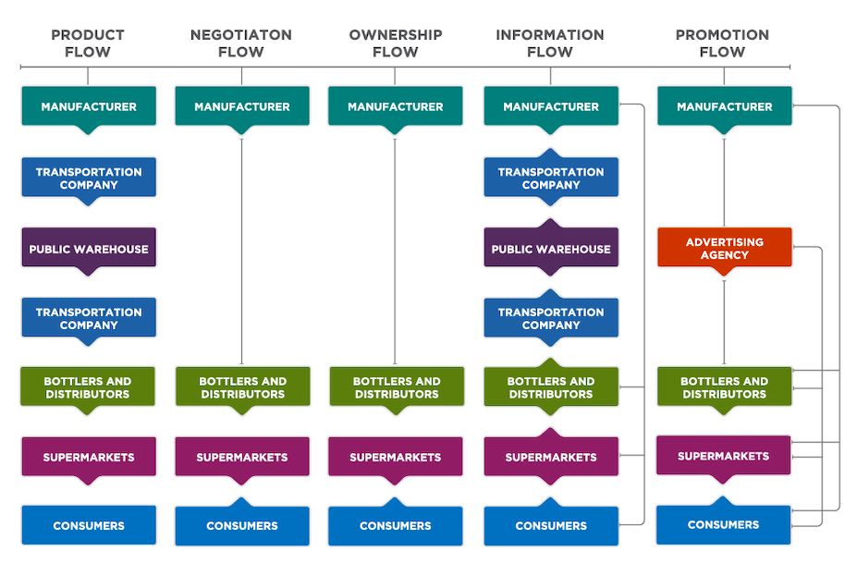
Five Flows in the Marketing Channel for Monster Beverages
Notes:
Monster Channel Flows. Provided by: Lumen Learning. License: CC BY: Attribution

Slide 4
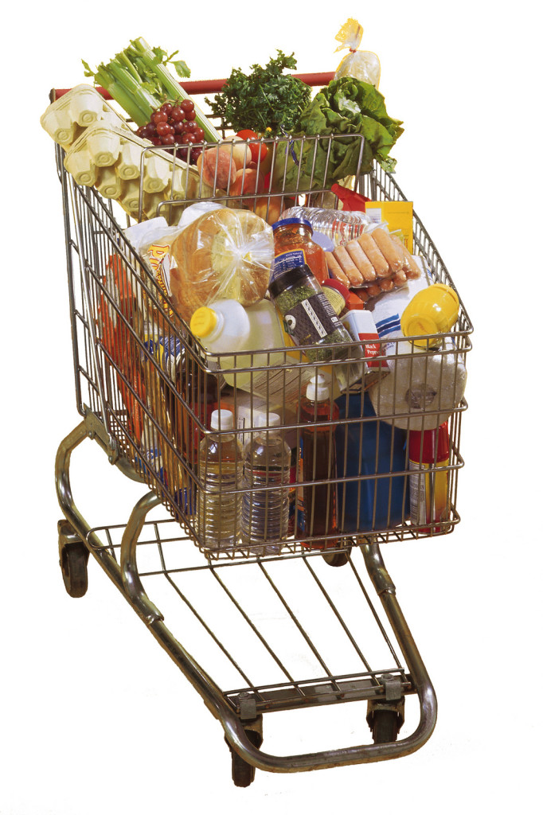
Channel Partners
The producer of the product: a craftsman, manufacturer, farmer, or other producer
The user of the product: an individual, household, business buyer, institution, or government
Middlemen at the wholesale and/or retail level
Notes:
Shopping Cart. Authored by: uacescomm. Located at: https://www.flickr.com/photos/uacescomm/21133249788/. License: CC0: No Rights Reserved

Slide 5
Channel Functions
Transactional functions: buying, selling, and risk assumption
Logistical functions: assembly, storage, sorting, and transportation
Facilitating functions: post-purchase service and maintenance, financing, information dissemination, and channel coordination or leadership

Slide 6
Channel Structures
While channels can be very complex, there is a set of channel structures that can be identified in most transactions:
Direct channel
Retail channel
Wholesale channel
Agent channel

Slide 7
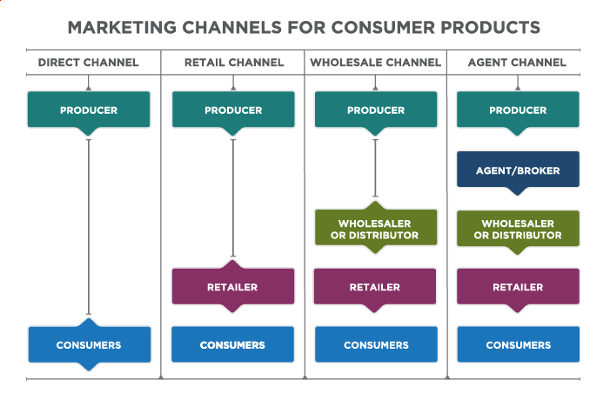
Marketing Channels for Consumer Products

Slide 8
Supply Chain vs. Marketing Channel
The supply chain and marketing channels can be differentiated in the following ways:
The supply chain is broader than marketing channels.
Marketing channels are purely customer facing.
Marketing channels are part of the marketing mix.

Slide 9
Channel Management: Analyze the Consumer
First, to whom shall we sell this merchandise immediately? Second, who are our ultimate users and buyers?
In both cases, certain basic questions apply: There is a need to know what the customer needs, where they buy, when they buy, why they buy from certain outlets, and how they buy
Manufacturers must also discover buying specifications for resellers

Slide 10
Channel Objectives
What must the channel achieve?
Examples:
Growth in sales by reaching new markets and/or increasing sales in existing markets.
Maintenance or improvement of market share
Achieve a pattern of distribution by a certain time, place, and form
Reduce costs or increase profits by creating an efficient channel

Slide 11
Specify Distribution Tasks
What functions does the channel need to perform? Examples:
Store inventory
Deliver goods
Provide credit
Handle product returns

Slide 12
Evaluate and Select Channel Alternatives
There are four considerations for channel alternatives:
Number of levels
Intensity at the various levels
Types of intermediaries at each level
Application of selection criteria to channel alternatives
In addition, it is important to decide who will be in charge of the selected channels.

Slide 13
Evaluate Channel Member Performance
It is important to evaluate the performance level of the channel members, but channel members are independent business firms, rather than employees and activities under its control, these firms may be reluctant to change their practices

Slide 14

Approaches to Support Third Party Sales Success
Understand and align incentives
Provide exceptional sales support
Create demand for your product
Notes:
Nanette Lepore. Authored by: Amber Karnes. Located at: https://www.flickr.com/photos/ambernussbaum/2850735703/. License: CC BY-NC-ND: Attribution-NonCommercial-NoDerivatives

Slide 15
Common Service Outputs
Special convenience: Can I get the product at or near the location where I want it?
Timing of availability: Do I need the product immediately or am I willing to wait?
Quantity: Am I willing to buy in bulk or buy multiple items?
Assortment and variety: Do I have a very particular need or a flexible need? Am I looking for one or many options?
Service: Do I require assistance or support through the purchase process?
Information: Do I need information to make a purchase?

Slide 16
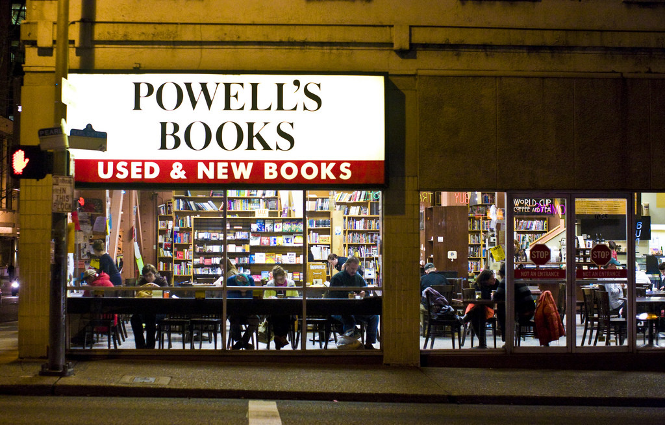
Retail
Retailing involves all activities required to market consumer goods and services to ultimate consumers who are purchasing for individual or family needs
Notes:
Powell's Books. Authored by: Thomas Hawk. Located at: https://www.flickr.com/photos/thomashawk/2987249389/. License: CC BY-NC: Attribution-NonCommercial

Slide 17
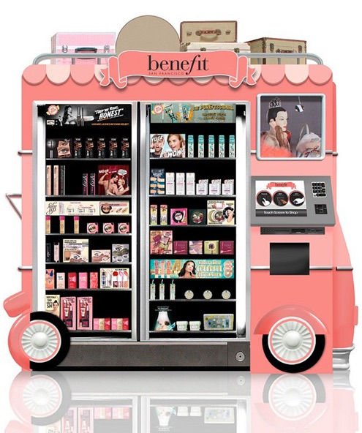
Types of Retail
Online
Catalog
Franchise
Supermarket
Malls and shopping centers
Chain store
Department store
Warehouse store
Non-store (right)
Notes:
Screenshot Benefit Cosmetics . Provided by: Lumen Learning. License: CC BY: Attribution

Slide 18
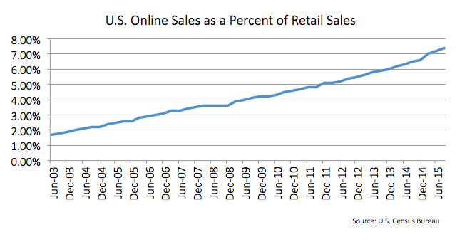
Online Sales are Growing, but Still Under 10%
Notes:
Revision and Adaptation. Provided by: Lumen Learning. License: CC BY: Attribution

Slide 19
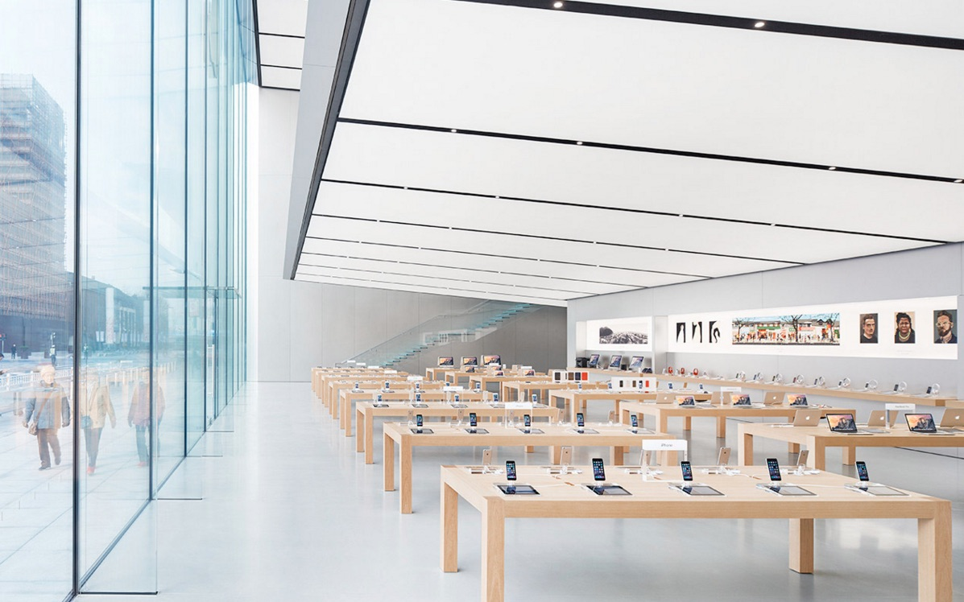
Retailers create a shopping experience through presentation and personnel
Notes:
Screentshot Apple Store. Provided by: Lumen Learning. License: CC BY: Attribution

Slide 20
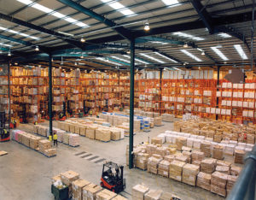
Supply Chain Management
The supply chain includes everything from product development, sourcing of materials, actual production, and transportation logistics
Supply chain management activities maximize customer value and allow the company to gain a competitive advantage
Notes:
Modern warehouse with pallet rack storage system. Authored by: Axisadman. Located at: https://commons.wikimedia.org/w/index.php?curid=9436500. License: CC BY-SA: Attribution-ShareAlike

Slide 21
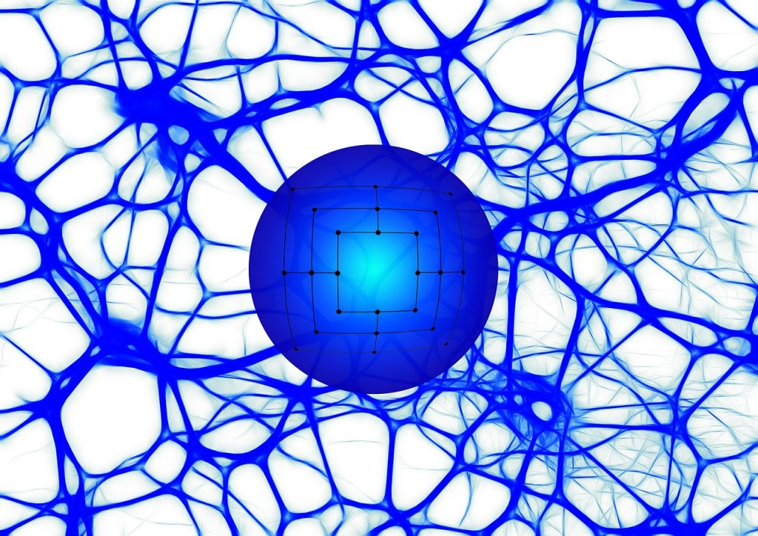
Integrated Supply Chain Management
Within the supply chain organization sourcing, demand planning, inventory planning, warehousing, logistics, and order-fulfillment functions must work together
Notes:
Network. Provided by: Pixabay. Located at: https://pixabay.com/en/network-ball-about-structure-441686/. License: CC0: No Rights Reserved

Slide 22
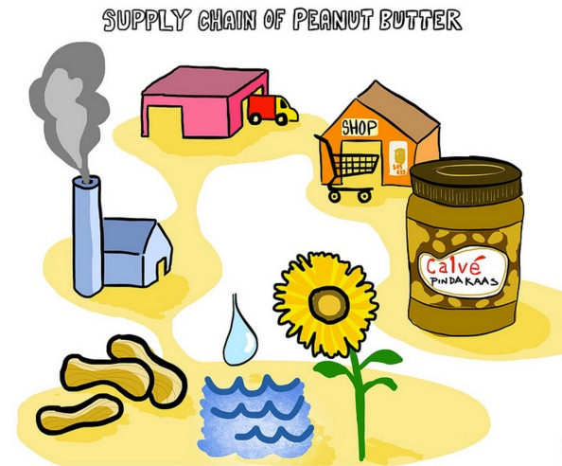
Practice Question
Here is a supply chain for peanut butter
How would a diagram of a marketing channel be similar? Different?
Notes:
Screenshot Supply Chain of Peanut Butter. Provided by: Lumen Learning. License: CC BY: Attribution

Slide 23
Quick Review
What are channels of distribution? Why do organizations use them?
How do channels affect the marketing of products and services?
What are the types of retailers? How are they used as a channel of distribution?
How does integrated supply chain management support an effective distribution strategy?

