Slide 1
Principles of Marketing
Module 11: Pricing Strategies
Notes:
All text in these slides is taken from https://courses.lumenlearning.com/wmopen-principlesofmarketing/, where it is published under one or more open licenses.
All images in these slides are attributed in the notes of the slide on which they appear and licensed as indicated.
Cover Image: "Shopping freak." Provided by: freestocks.org. Located at: https://unsplash.com/photos/_3Q3tsJ01nc. Content Type: CC Licensed Content, Shared Previously. License: CC0: No Rights Reserved.

Slide 2
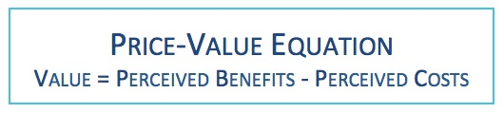
How Customers View Price

Slide 3
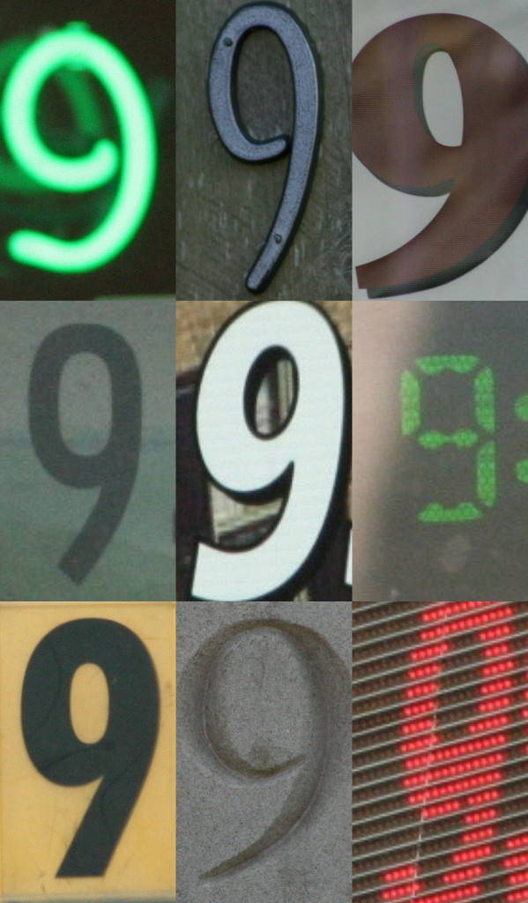
Psychology of Price
Customers are more likely to buy products whose price points end in the number nine
Anchoring can change customer perceptions of price
Notes:
Nineru20149/9/09. Authored by: Malia. Located at: https://www.flickr.com/photos/malia111/3905163055/. License: CC BY-NC-ND: Attribution-NonCommercial-NoDerivatives

Slide 4

Pricing Strategies.
Profit-oriented pricing
Competitor-oriented pricing
Customer-oriented pricing
Notes:
Best Price. Located at: https://pixabay.com/en/award-price-tag-note-board-offer-73084/. License: CC0: No Rights Reserved

Slide 5
Profit Oriented Pricing
Focus on finances of business and product
  profit = revenue - price
Price per product is set higher than the total cost of producing and selling cost
Ensures company makes a profit on each sale
Risks
Customers don’t care about a company’s costs
Competitors can undercut pricing
Limits pricing flexibility

Slide 6
Van Westendorp Price Sensitivity Questions
At what price would you consider the product to be so expensive that you would not consider buying it? (Too expensive)
At what price would you consider the product to be priced so low that you would feel the quality couldn’t be very good? (Too cheap)
At what price would you consider the product starting to get expensive, such that it’s not out of the question, but you would have to give some thought to buying it? (Expensive/High Side)
At what price would you consider the product to be a bargain—a great buy for the money? (Cheap/Good Value)

Slide 7
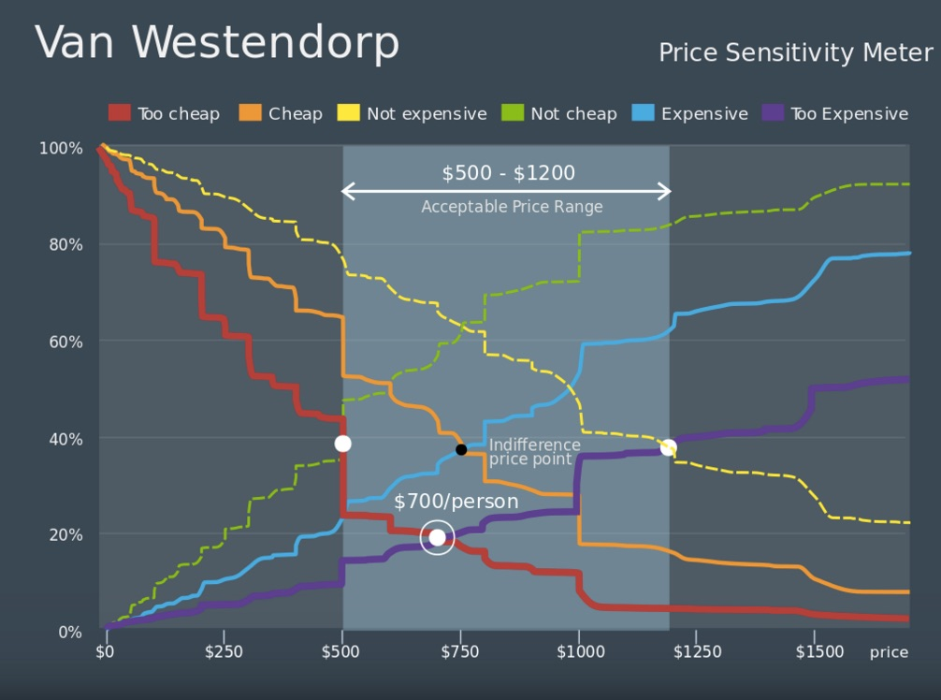
Van Westendorp Price Sensitivity Meter
Notes:
Van Westendorp Price Sensitivity Meter. Provided by: Wikipedia. Located at: https://en.wikipedia.org/wiki/Van_Westendorp%27s_Price_Sensitivity_Meter. License: CC BY-SA: Attribution-ShareAlike

Slide 8
Other Pricing Strategies
Profit objective: For example, “Increase net profit in 2016 by 5 percent”
Competitive objective: For example, “Capture 30 percent market share in the product category”

Slide 9
Break-Even Price
The break-even price is the price that will produce enough revenue to cover all costs at a given level of production.
p = (Vn + FC) / n
n = FC /( p – V)
p is price
n is number of units sold
V is variable cost per unit
FC is fixed costs

Slide 10
Competitive Pricing
Matching competitor price requires competing on the other parts of the marketing mix
Pricing above competition requires a clear advantage on some nonprice element of the marketing mix
Pricing below the competition to increase sales volume with lower profit margins is effective if a significant segment of the market is price sensitive and/or the organization’s cost structure is lower than competitors
The risk of competing on price is a price war

Slide 11
Value-based Pricing
“Price is what you think your product is worth to that customer at that time.” This approach regards the following as marketing/price truths:
To the customer, price is the only unpleasant part of buying.
Price is the easiest marketing tool to copy.
Price represents everything about the product.
Still, value-based pricing is not altruistic. It asks and answers two questions:
What is the highest price I can charge and still make the sale?
Am I willing to sell at that price?

Slide 12
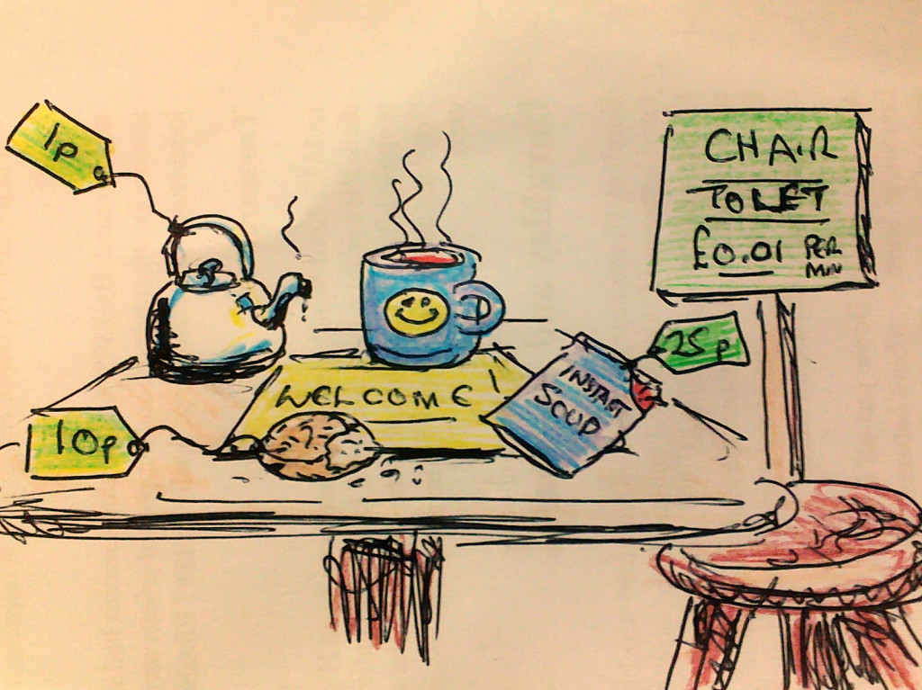
Tactical Recommendations from Value-based Pricing
Employ a segmented approach toward price that considers how each group of customers assesses value
Establish the highest possible price level and justify it with comparable value
Use price as one component in the marketing mix, building compelling value across all elements of the offering
Notes:
Hot Soup Charitable Elephants. Authored by: Julian Partridge. Located at: https://www.flickr.com/photos/julianpartridge/11512394244/. License: CC BY-SA: Attribution-ShareAlike

Slide 13
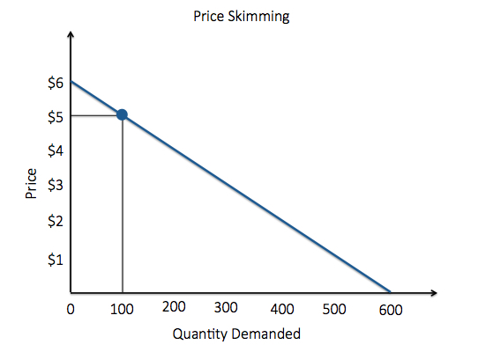
Price Skimming
A firm charges the highest initial price that customers will pay
As the demand of the first customers is satisfied, the firm lowers the price to attract another, more price-sensitive segment
Notes:
Revision and Adaptation. Authored by: Lumen Learning. License: CC BY-SA: Attribution-ShareAlike

Slide 14
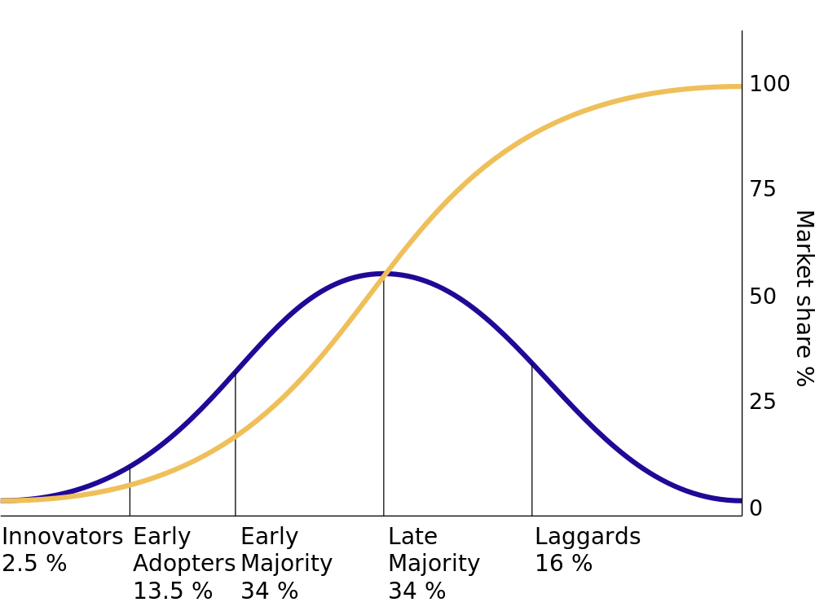
Price Skimming and Customer Segmentation
Price skimming can also be part of a customer segmentation strategy.
Notes:
Revision and Adaptation. Authored by: Lumen Learning. License: CC BY-SA: Attribution-ShareAlike

Slide 15
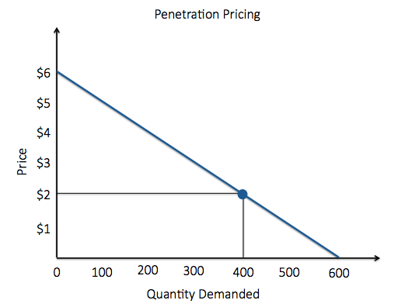
Penetration Pricing
The price of a product is initially set low to rapidly reach a wide fraction of the market and initiate word of mouth to enlarge market share and exploit economies of scale
Notes:
Revision and Adaptation. Provided by: Lumen Learning. License: CC BY-SA: Attribution-ShareAlike

Slide 16
Advantages of Penetration Pricing
It can result in fast diffusion and adoption across the product life cycle
It can create goodwill among the Innovators and Early Adopters
It establishes cost-control and cost-reduction pressures from the start, leading to greater efficiency
It discourages the entry of competitors and takes existing competitors by surprise
It can generate high stock turnover throughout the distribution channel, which creates important enthusiasm and support in the channel

Slide 17

Disadvantages of Penetration Pricing
Can create long-term price expectations for the product and image preconceptions for the brand and company that make it difficult to raise prices later
low profit margins may not be sustainable long enough for the strategy to be effective
Notes:
Mallards Feeding. Authored by: Yankech Gary. Located at: https://www.flickr.com/photos/49663413@N08/6965646827/. License: CC BY-ND: Attribution-NoDerivatives

Slide 18
Cost-plus Pricing
Cost-plus pricing, sometimes called gross margin pricing
  Most widely used pricing method
  The manager selects as a goal a particular gross margin that will produce a desirable profit level
  Gross margin is the difference between how much the goods cost and the actual price for which it sells
  This gross margin is designated by a percent of net sales
  The percent chosen varies among types of merchandise

Slide 19
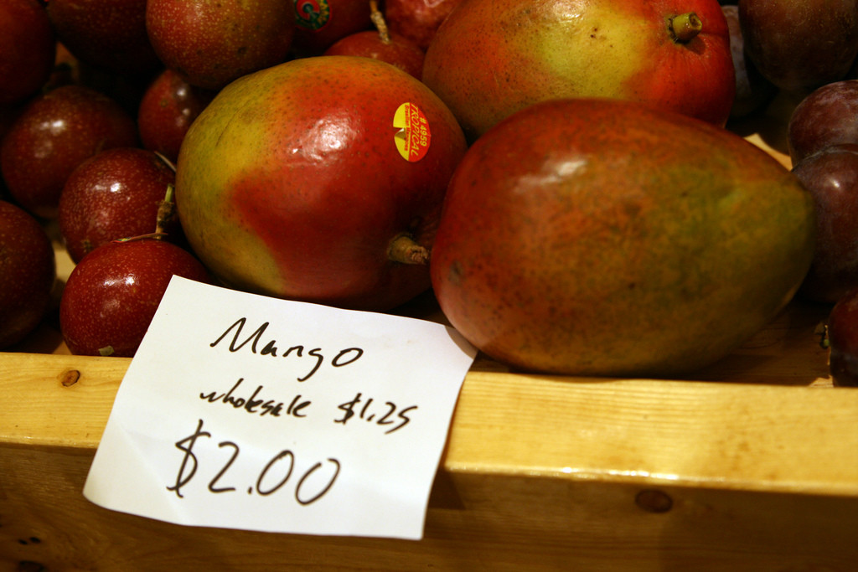
Markup
When middlemen use the term markup, they are referring to the difference between the average cost and price of all merchandise in stock, for a particular department, or for an individual item
Notes:
Mangos. Authored by: Quinn Dombrowski. Located at: https://www.flickr.com/photos/quinnanya/2886818380/. License: CC BY-SA: Attribution-ShareAlike

Slide 20
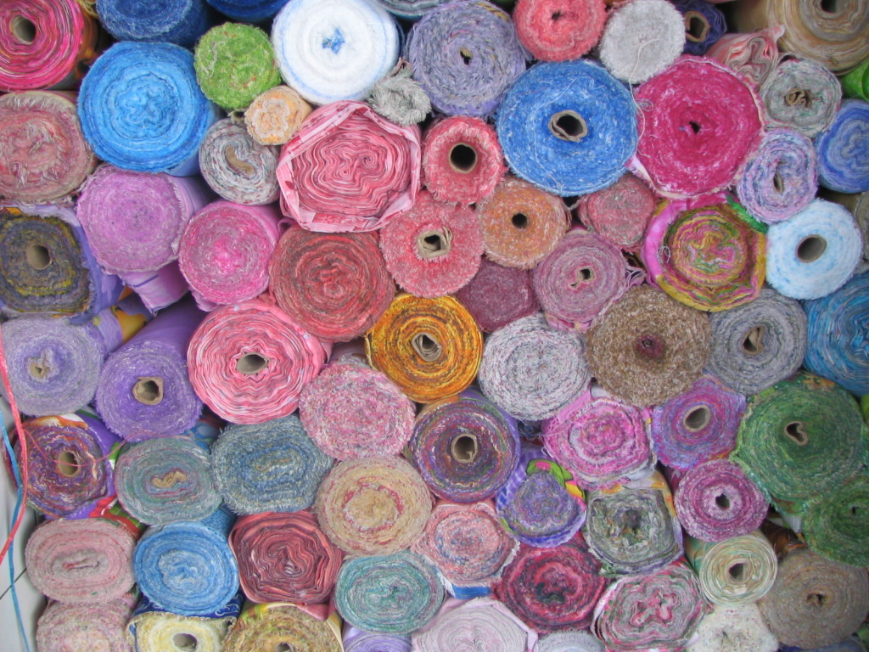
Discounting Strategies
Quantity discounts
Seasonal discounts
Cash discounts
Trade discounts (given to middlemen)
Personal allowances (rewards to salespeople)
Trade-in allowances (cars)
Price bundling (cable) package)
Notes:
Fabric Bolts. Authored by: Laura. Provided by: Pixabay. Located at: https://www.flickr.com/photos/luckylaura/2749694639/. License: CC BY: Attribution

Slide 21
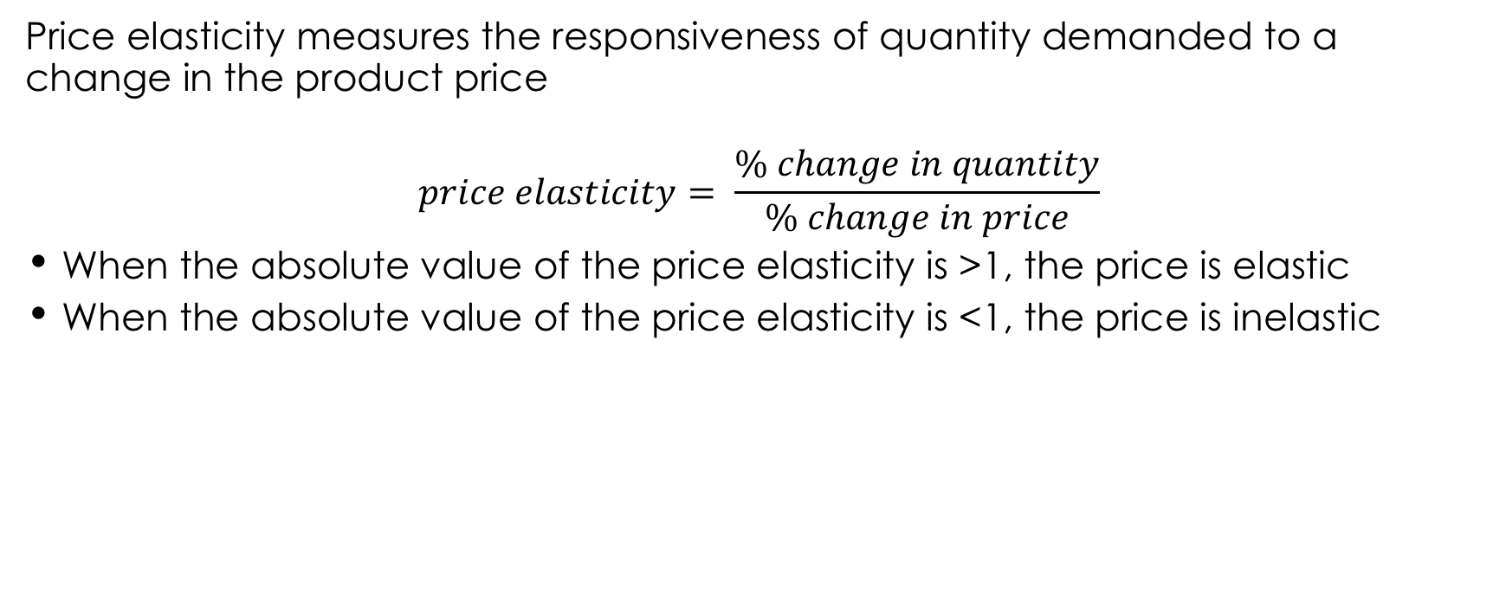
Price Elasticity
Price elasticity measures the responsiveness of quantity demanded to a change in the product price
$$price elasticity= \frac{\% change in quantity}{\% change in price}$$
When the absolute value of the price elasticity is >1, the price is elastic
When the absolute value of the price elasticity is <1, the price is inelastic

Slide 22
What Determines Price Elasticity
Substitutes
Absolute price
Importance of use
Competitive dynamics

Slide 23
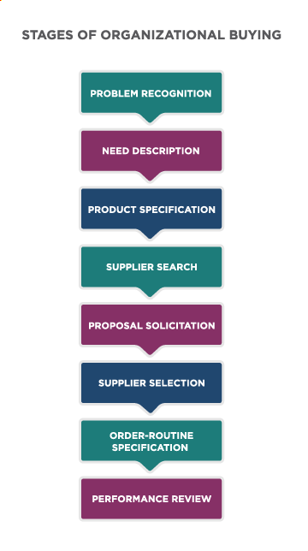
Competitive Bidding
A competitive bid is a procurement process in which bids from competing suppliers are solicited
Advertises the requirements and specifications of solutions and invites suppliers to provide a proposal about how they will meet the need and at what price.
opportunity to tailor pricing for a specific customer’s needs
Notes:
Competitive Bidding. Provided by: Lumen Learning. License: CC BY: Attribution

Slide 24

Don’t Compete on Price Alone
Price is not a sustainable competitive advantage
Low prices can jeopardize a company’s ability to profitably deliver sustained value
Notes:
Competitive Kiting. Authored by: Daniel Parks. Located at: https://www.flickr.com/photos/parksdh/14830636071/. License: CC BY-NC: Attribution-NonCommercial

Slide 25
Practice Question
Compare and contrast price skimming and penetration pricing.
Notes:
Both are used in new markets or with new products. However they are opposite strategies. One lowers the price to increase the market share and the other raises it once market share is reached.

Slide 26
Quick Review
How does price affect the value of the organization’s products or services?
What are the primary factors to consider in pricing?
Compare common pricing strategies.
What is price elasticity and how can it be used to set price?
What is competitive bidding and how is it used for B2B pricing?

