Slide 1
Principles of Marketing
Module 7: Consumer Behavior
Notes:
All text in these slides is taken from https://courses.lumenlearning.com/wmopen-principlesofmarketing/, where it is published under one or more open licenses.
All images in these slides are attributed in the notes of the slide on which they appear and licensed as indicated.
Cover Image: "Shopping freak." Provided by: freestocks.org. Located at: https://unsplash.com/photos/_3Q3tsJ01nc. Content Type: CC Licensed Content, Shared Previously. License: CC0: No Rights Reserved.

Slide 2
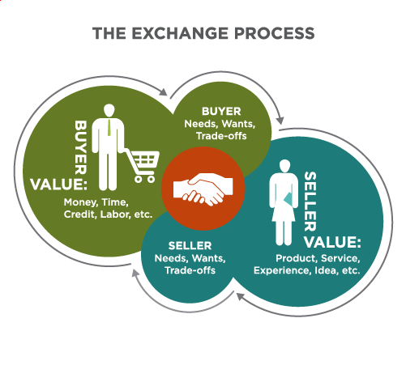
The Exchange Process
Notes:
Revision and Adaptation. Authored by: Lumen Learning. License: CC BY: Attribution

Slide 3
Theories of Consumer Behavior: The Economic Man
According to the “economic man” model, consumers are rational and narrowly self-interested, always trying to maximize the benefits they derive from the exchange process
Limitations: People are not always rational or they define value differently than this model would suggest

Slide 4
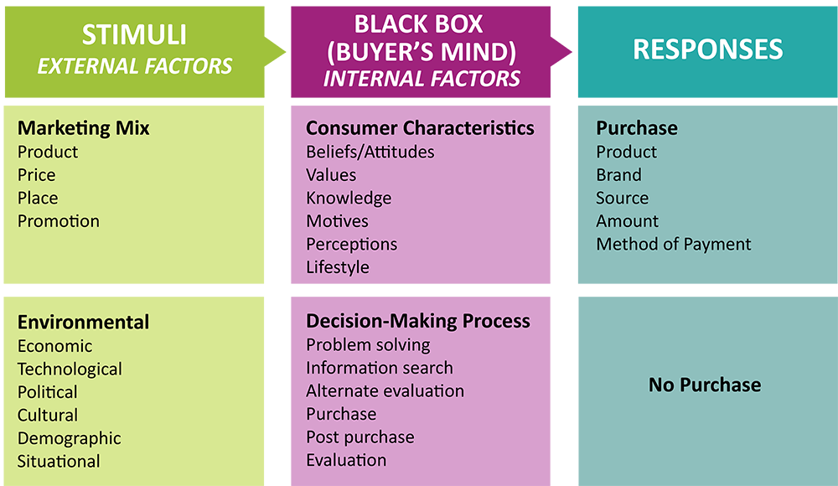
The Stimulus Response Model
Notes:
Revision and Adaptation. Authored by: Lumen Learning. License: CC BY: Attribution

Slide 5
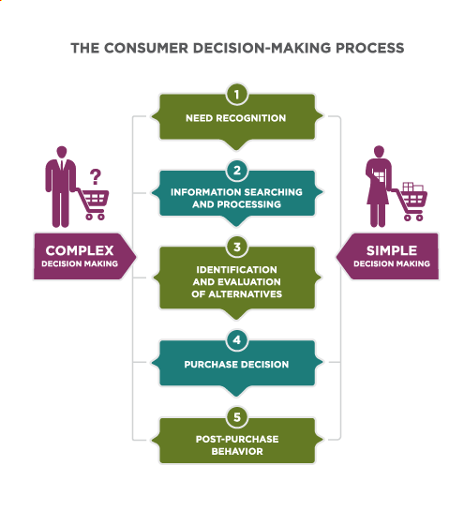
Consumer Decision-Making Process
Notes:
Revision and adaptation. Provided by: Lumen Learning. License: CC BY: Attribution

Slide 6
Needs Recognition
Consumer
Marketer Role
Whether we act to resolve a particular problem depends upon two factors:
  the magnitude of the difference between what we have and what we need, and
  the importance of the problem
Know what problems consumers are facing, so the marketing mix fits
Activate problem recognition to trigger the purchasing process
Shape how consumers define the need or problem

Slide 7
Information Search
Consumer
Marketer
Seeks information
May come from past experience, word of mouth, or research
Promotions should give consumers the info they seek in the places they look for it

Slide 8
Evaluation of Alternatives
Consumer
Marketer
Develop a criteria to make a choice and evaluate options based on that criteria
Understand your target consumer’s evaluation criteria is critical. Your product needs to demonstrate these qualities in order to be short-listed in the selection set

Slide 9
Purchase Decision
Consumer
Marketer
Decide and buy
Try to simplify the purchase decision
Be aware of point of sale factors

Slide 10
Postpurchase Behavior
Consumer
Marketer
May experience postpurchase anxiety due to cognitive dissonance
New-customer communications that confirm the quality and popularity of the product
Providing personal reinforcement has proven effective with big-ticket items such as automobiles and major appliances

Slide 11
High-involvement Decisions
High-involvement decisions are important to the buyer
These decisions are closely tied to the consumer’s ego and self-image
They also involve some risk to the consumer, such as:
Financial risk (highly priced items)
Social risk (products that are important to the peer group)
Psychological risk (the wrong decision may cause the consumer some concern and anxiety)

Slide 12
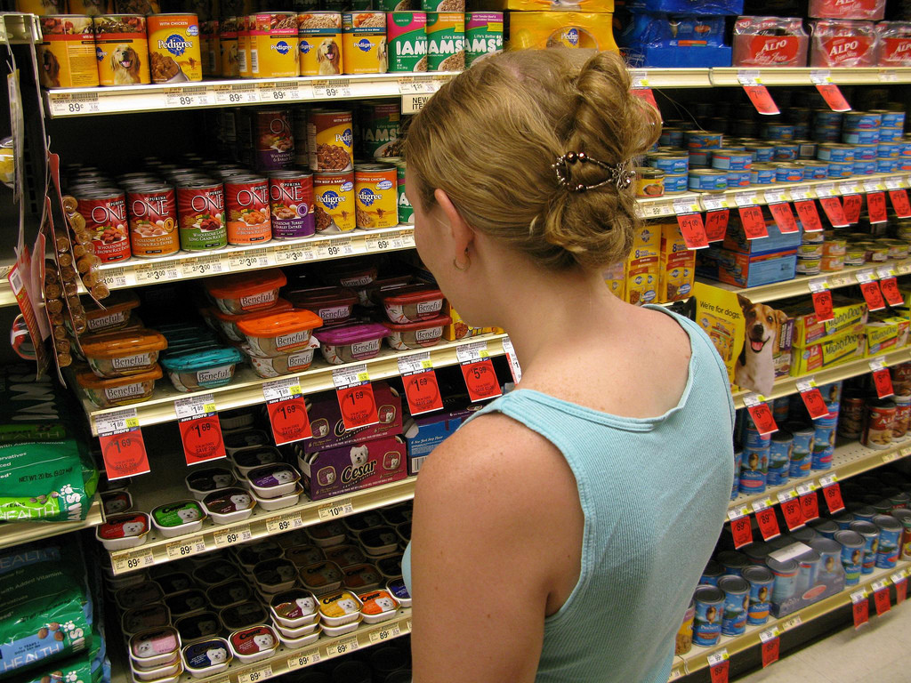
Low-involvement Decisions
Straightforward
Require little risk
Are repetitive and often lead to a habit
Not very important to the consumer
Notes:
Dog Food Selection. Authored by: Christopher. Located at: https://www.flickr.com/photos/colorblindpicaso/2676714959/. License: CC BY-NC: Attribution-NonCommercial

Slide 13
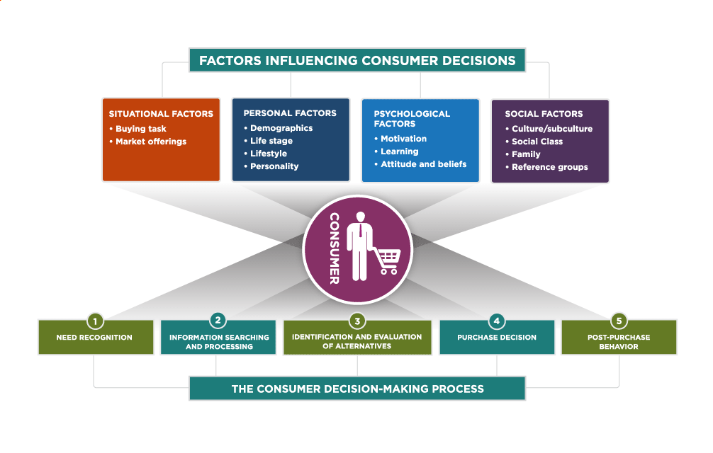
Factors Influencing Consumer Decisions and the Consumer Decision-Making Process
Notes:
Revision and Adaptation. Authored by: Lumen Learning. License: CC BY: Attribution

Slide 14
Demographics
The Millennial Generation, Born: 1980 to 1997
Generation X, Born: 1965 to 1980
The Baby Boom Generation, Born: 1946 to 1964
The Silent Generation, Born: 1928 to 1945
The Greatest Generation, Born: Before 1928
Note that no chronological end point has been set for the Millenials. For the purpose of following a cleanly defined group, they’re defined as those aged 19 to 35 in 2016.
Notes:
Revision and Adaptation. Provided by: Lumen Learning. License: CC BY: Attribution

Slide 15
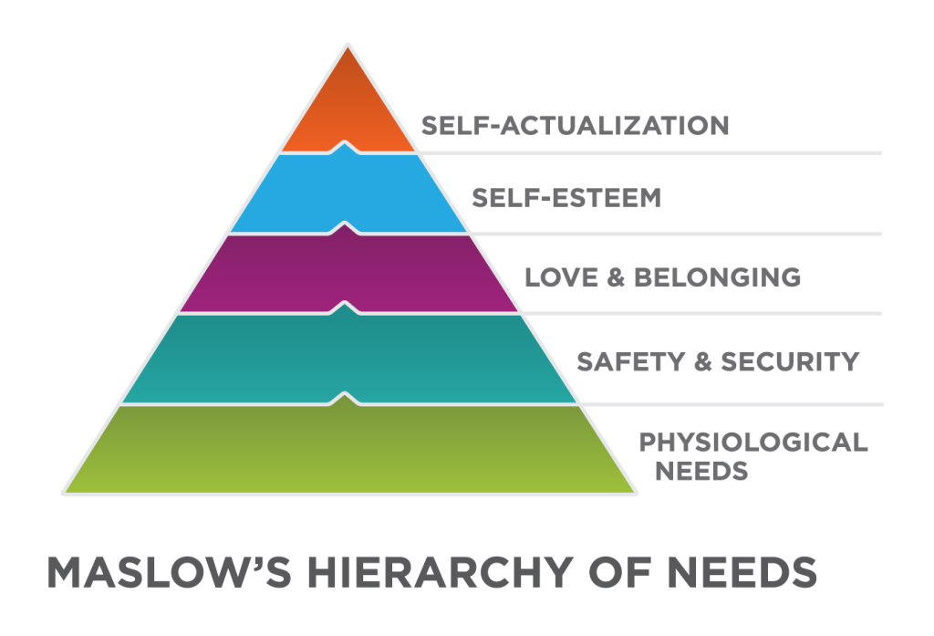
Psychological Factors
Notes:
Revision and adaptation. Provided by: Lumen Learning. License: CC BY: Attribution

Slide 16
Social Factors: Class
Upper Class makes up 1% of the population.
Upper Middle Class makes up 15% of the population.
Lower Middle Class makes up 32% of the population.
Working class makes up 32% of the population.
Lower Class makes up 20% of the population
Notes:
Revision and Adaptation. Authored by: Lumen Learning. License: CC BY: Attribution

Slide 17
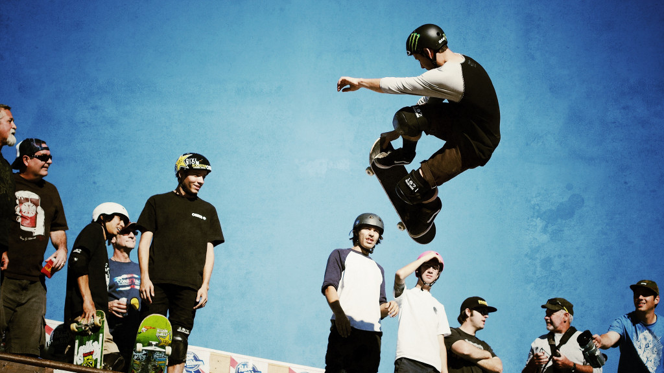
Reference Groups
Reference groups are formal or informal groups with opinion leaders
Can influence an individual in several ways:
Role expectations
Conformity
Group communications through opinion leaders
Word of mouth influence
Notes:
Jeff Phillips SK8 Party. Authored by: Scott Lumley. Located at: https://www.flickr.com/photos/scottlumley/10692510614/. License: CC BY: Attribution

Slide 18
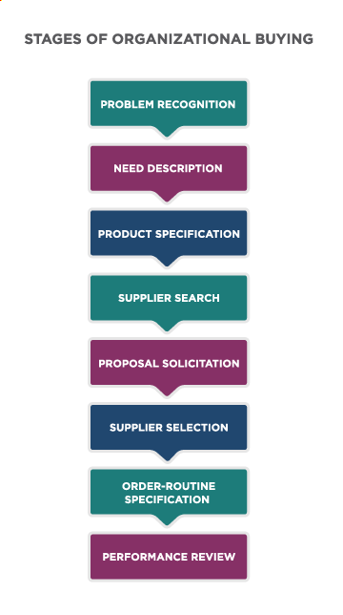
B2B Decision Making Stages
Notes:
Revision and Adaptation . Authored by: Lumen Learning. License: CC BY: Attribution

Slide 19
Low-involvement B2B Decisions
For rebuys and routine purchases, organizations use abridged versions of the process
Some stages may be bypassed completely when a supplier has already been selected

Slide 20
Considerations in B2B Marketing
Who will take part in the buying process?
What criteria does each person use to evaluate prospective suppliers?
What level of influence does each member of the process have?
What interpersonal, psychological, or other factors about the decision team might influence this buying process?
How well do the individuals work together as a group?
Who makes the final decision to buy?

Slide 21
Complexity of B2B Buying
Timing
Technical specifications of the physical products, or complex technical specifications associated with services, timing, and terms of delivery and payment.
Organizational

Slide 22

Unique Factors that Shape B2B
B2B purchasing decisions are influenced by a variety of factors that are unique to organizations, the people they employ, and the broader business environment
Notes:
Untitled. Authored by: StartupStockPhotos. Provided by: Pixabay. Located at: https://pixabay.com/photos/entrepreneur-startup-start-up-man-593358/. License: CC0: No Rights Reserved. License Terms: Pixabay License

Slide 23
Practice Questions
Compare and contrast the buying process for
A car
A bag of rice
A large, expensive photocopier
Notes:
Buying a car is big and potentially risky decision. Customers will do more research and go through all the steps. A bag of rice is usually a fairly routine process. The photocopier is probably a B2B purchase and that process differs from the B2C process.

Slide 24
Quick Review
What are the stages of the consumer buying process?
Contrast the buying processes for low-involvement and high-involvement decisions?
What are the major factors that influence consumer purchasing decisions?
What are the B2B buying process and key factors influencing B2B purchasing decisions?

