Slide 1
Principles of Marketing
Module 6: Marketing Information and Research
Notes:
All text in these slides is taken from https://courses.lumenlearning.com/wmopen-principlesofmarketing/, where it is published under one or more open licenses.
All images in these slides are attributed in the notes of the slide on which they appear and licensed as indicated.
Cover Image: "Shopping freak." Provided by: freestocks.org. Located at: https://unsplash.com/photos/_3Q3tsJ01nc. Content Type: CC Licensed Content, Shared Previously. License: CC0: No Rights Reserved.

Slide 2
Types of Marketing Information: Internal Data
Large databases collect massive amounts of data from a variety of sources: customer demographic and profile data linked to in-store and online purchasing history, Web site search terms, page views, social media posts, and other data
In a process called data mining, computer algorithms search for patterns in the data and generate recommendations and insights about how to increase sales

Slide 3
Competitive Intelligence
Competitive intelligence is marketing information that helps marketers and other members of an organization better understand their competitors and competitive market dynamics, such as:
Product information
Market share and penetration
Pricing strategy
Competitive positioning and messaging
Win/loss analysis

Slide 4
Marketing Research
Marketing research is a systematic process for identifying marketing opportunities and solving marketing problems
Uses customer insights that come out of collecting and analyzing marketing information

Slide 5
Environmental Factors
Market research examines environmental factors and how they affect consumer behavior:
Health of the economy
Legal environment
Market trends
Technology and its influence
Cultural factors

Slide 6

Customer Attitudes, Behaviors, and Perceptions
Marketing research can be essential in understanding customer needs
How their needs are or aren’t being met by the market
Views about various products and companies
Satisfaction levels, preferences for product features and pricing
Consumer decision-making process, and factors that influence it.
Notes:
Urban life (Version 2.0). Authored by: Ian D. Keating. Located at: https://www.flickr.com/photos/ian-arlett/19313315520/. License: CC BY: Attribution

Slide 7
Product Research
Product research explores . . .
Opportunities and gaps exist for improving existing products or introducing new ones
Concept testing
Sizing the market for a product
Market penetration
Prioritizing product features and preferences
Resting product effectiveness
Customer receptivity
User testing
Pricing strategies,
Product naming and branding
How to position a product relative to competitors

Slide 8

Marketing, Advertising, and Promotion Research
This area of research seeks to improve the effectiveness and reach of marketing activities such as market segmentation, messaging and communications, advertising and media testing, events and sponsorships, packaging and display testing
Notes:
Chapter 3: Marketing Research: An Aid to Decision Making, from Introducing Marketing. Authored by: John Burnett. Provided by: Global Text. Located at: http://solr.bccampus.ca:8001/bcc/file/ddbe3343-9796-4801-a0cb-7af7b02e3191/1/Core%20Concepts%20of%20Marketing.pdf. License: CC BY: Attribution

Slide 9

Corporate Research
Corporate research investigates corporate reputation and opportunities for strengthening an organization’s position in the market through brand building, research and development, mergers and acquisitions, strategic partnerships, corporate planning and profitability
Notes:
Target Shopper. Authored by: Wm. Mag.. Located at: https://www.flickr.com/photos/jojomelons/2041121410/. License: CC BY-NC-ND: Attribution-NonCommercial-NoDerivatives

Slide 10
Questions to Ask in Market Research
Who is the customer?
What problems is the customer trying to solve with a given purchase?
What does the customer desire in the way of satisfaction?
How does the customer get information about available choices?
Where does the customer choose to purchase?
Why does the customer buy, or not buy?
When does the customer purchase?
How does the customer go about seeking satisfaction in the market?

Slide 11
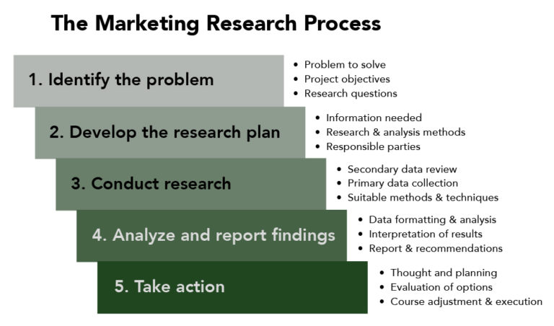
Marketing Research Process
Notes:
Revision and Adaptation. Authored by: Lumen Learning. License: CC BY: Attribution

Slide 12
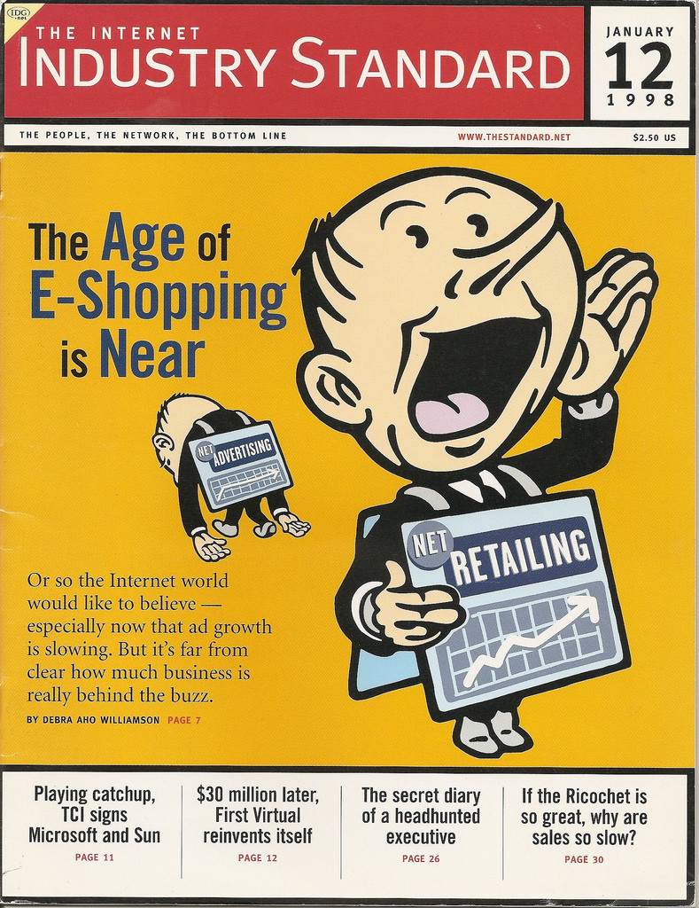
Secondary Research
Secondary research uses information that has previously been collected either inside or outside the organization such as:
Internal data
Government and non-governmental organization
Industry associations, journals, and media
Commercial market research data
Search engine results
Notes:
The Industry Standard Cover. Authored by: Matt McAlister. Located at: https://www.flickr.com/photos/mattmcalister/3600857428/. License: CC BY-NC: Attribution-NonCommercial

Slide 13
Advantages and Disadvantages of Secondary Research
Advantages
Disadvantages
Less expensive
Less time intensive
Information may be somewhat dated
Probably does not address your exact problem with your exact market and competitive dynamics

Slide 14
Quantitative vs. Qualitative Research
Qualitative research explores ideas, perceptions, and behaviors in depth with a relatively small number of research participants. It aims to answer questions with more complex, open-ended responses.
Quantitative research collects information that can easily be counted, tabulated, and statistically analyzed.

Slide 15

Qualitative Research Methods
behavioral observation
in-depth interviews
focus groups
social listening
Notes:
Interview. Authored by: Amy Hirschi. Provided by: Unsplash. Located at: https://unsplash.com/photos/JaoVGh5aJ3E. License: CC0: No Rights Reserved. License Terms: Unsplash License

Slide 16
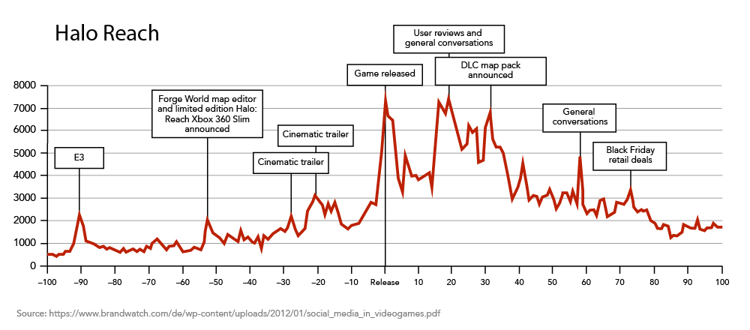
Social Listening
Social listening is a systematic process for tracking what is being said about a given topic in forums such as Facebook, Twitter, LinkedIn, blogs, and even mainstream media.

Slide 17
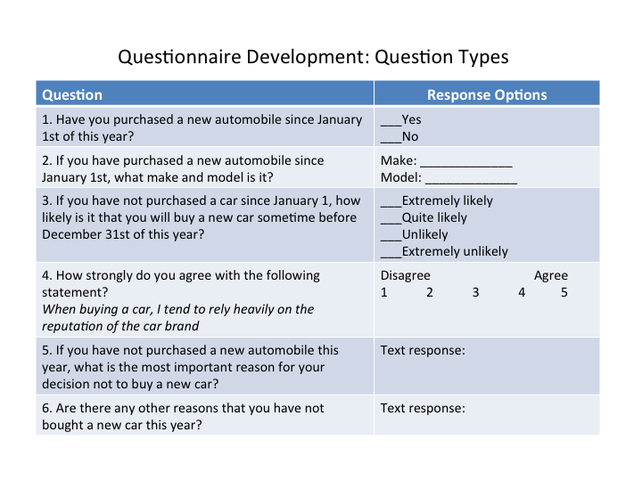
Quantitative: Surveys
Surveys ask individual consumers to give responses to a questionnaire.
Notes:
Revision and Adaptation. Authored by: Lumen Learning. License: CC BY: Attribution

Slide 18
Marketing Research Contact Methods: Pros and Cons
Contact Method | Advantages | Disadvantages
Telephone | Good control over who participates Quick, timely data collection | Moderately expensive Low response rates (fewer people answer phones) Interviewer quality may affect results Questionnaire length limitations
Mail | Inexpensive | Little control over who participates Data collect takes longer Low response rates
In-person | Great control over who participates Quick, timely data collection Fairly good response rates Great for capturing in-depth detail | Very expensive Interviewer quality may affect results Questionnaire length limitations
Online | Inexpensive Timely data collection Low cost to continue data collection | Little control over who participates Greater possibility for self-selection bias misses people who aren’t online
Notes:
Revision and Adaptation. Authored by: Lumen Learning. License: CC BY: Attribution

Slide 19
Quantitative: Experiments
A typical example is A/B testing in marketing campaigns. In an A/B test, the marketers use two different versions of promotional materials with two samples of target customers and then track the results to see which version is most effective.

Slide 20

Sampling
A sample is a group of elements (persons, stores, financial reports) chosen for research purposes from among a “total population” or “universe” of all possible participants who fit the target criteria for research subjects.
Notes:
USAG-Humphreys teens participate in a focus group. Provided by: USAG-Humphreys. Located at: https://www.flickr.com/photos/usaghumphreys/3568673346/. License: CC BY: Attribution

Slide 21
Analyzing Primary Data
Analyzing data is the process of interpreting what it means, generating recommendations, and reporting results to the appropriate stakeholders within an organization.
Qualitative: Summarizing key themes and takeaways as well as including verbatim comments from research participants that express important points.
Quantitative research: Researchers apply a variety of statistical tabulations and tests to determine what the data are saying, which findings are truly significant, and what meaningful correlations or relationships exist to offer new insights about the target segment.

Slide 22
Publicly Available Data Sources
Website | Description
Data.gov | A centralized portal for open data available from the U.S. government
FedStats | A U.S. government-maintained Web site that provides access to a wide variety of statistical data published by the federal government.
Google Public Data Directory | A directory of publicly-available data sources from around the world.
Google Trends | A search tool for exploring search volume for any term used in a Google search.
Pew Research Center | Public opinion and research reports from a non-partisan, American think tank.
U.S. Bureau of Economic Analysis | Data published by the federal government about economic indicators for the economy as a whole, as well as specific industries and economic sectors.
U.S. Census Bureau Data | Demographic and geographic information about the population of the United States.
Notes:
Marketing Information: Where the Data Are. Authored by: Lumen Learning. License: CC BY: Attribution

Slide 23
Publicly Available Data Sources (continued)
Website | Description
U.S. Small Business Administration (SBA) General Business Data and Statistics | A collection of data about the U.S. economy, industries, businesses and the general population, developed with business users in mind.
United Nations UNdata | A data service of the United Nations that provides centralized access to a wide variety of U.N.-maintained data sets such as demographics, socioeconomic status and development indicators for nations around the world.
World Bank Data | Economic data and economic development indicators for 100+ countries around the world.
World Trade Organization (WTO) Data | Information about international trade and tariffs and the regulatory environment for 100+ WTO member countries.
Notes:
Marketing Information: Where the Data Are. Authored by: Lumen Learning. License: CC BY: Attribution

Slide 24
Syndicated Marketing Research Data
Website | Description
Acxiom | Extensive consumer datasets containing demographic, purchasing, credit, and other information companies can map to their own customer and prospect data for research, marketing analytics, and marketing campaign execution.
Experian | Extensive consumer datasets containing demographic, purchasing, credit, and other information that companies can map to their own consumer and prospect data for research, marketing analytics, and marketing campaign execution.
GfK MRI (formerly MediaMark) | Extensive datasets around multimedia audience research and measurement.
Ipsos | The Affluent Survey USA is an annual survey tracking media and consumer spending habits of U.S. households in the top 20% income level.
IRI | Point-of-sale data linked to household panel purchasing data, providing detail around sales, pricing, promotion and market share for a variety of consumer products.
Notes:
Marketing Information: Where the Data Are. Authored by: Lumen Learning. License: CC BY: Attribution

Slide 25
Syndicated Marketing Research Data (continued)
Website | Description
Media Audit | Audience demographics and media consumption profiles for 100+ media markets in the U.S.
Nielsen | Point-of-sale data linked to household panel purchasing data, providing detail around sales, pricing, promotion and market share for a variety of consumer products. Datasets to support popular lifestyle and behavioral segmentation systems such as PRIZM.
Roper Center for Public Opinion Research | Database of public opinion and polling questions exploring many aspects of American life, including contemporary data as well as polling data dating back to the 1930s.
Yankelovich | MONITOR provides long-running syndicated research about consumer values, attitudes, and trends.
Notes:
Marketing Information: Where the Data Are. Authored by: Lumen Learning. License: CC BY: Attribution

Slide 26
Other Sources of Marketing Data
Website | Description
Google Analytics | Detailed analytics, statistics and insights about Web site traffic, usability and sales effectiveness. Free and premium services available.
LexisNexis | Searchable source for full-text articles from regional, national and international newspapers, government documents, and many legal, medical and business publications.
Statista | A subscription-based statistics portal, providing searchable access to many original sources of market, industry, and business data.
Notes:
Marketing Information: Where the Data Are. Authored by: Lumen Learning. License: CC BY: Attribution

Slide 27
CRM
CRM systems are powerful software systems that serve several essential functions for marketing, sales, and account management. Organizations use them to:
Capture internal data about customers and customer interactions and house these data in a central location
Provide business users with access to customer data in order to inform a variety of customer touch points and interactions
Conduct data analysis and generate insights about how to better meet the needs of target segments and individual customers
Deliver a marketing mix tailored to the needs and interests of these target segments and individual customers

Slide 28
Using Marketing Information to Shape Marketing Strategy
Different elements require different types of questions:
Target Segment(s)
Product
Promotion
Price
Place

Slide 29
Types of Questions to Explore: Target Segment(s)
What new insights do we have about our target segment(s)?
Which problems should we be solving for our customers?
Are we targeting the right segments?

Slide 30
Types of Questions to Explore: Product
What attracts customers to our products?
What improvements would make them even more attractive to our target segments?

Slide 31
Types of Questions to Explore: Promotion
What types of messages will make target segments want our products?
What types of promotional campaigns will work best for each target segment?
Who do out target segments listen to, and what are they saying about us?

Slide 32
Types of Questions to Explore: Price
How are we going at providing good value for the price?
How does out pricing affect customers' willingness to buy?
How would changes to pricing affect sales?

Slide 33
Types of Questions to Explore: Place
Are we offering our products in the places and times that target segments feel the need for them? If now, how can we improve?
How can we make it easier for customers to find and buy our products?
Are there more efficient ways for us to get out products into customers' hands?

Slide 34

Don’t Forget to Measure Impact!
This link between taking action and measuring results is important. It provides a continuing stream of marketing information to help marketers understand if they are on the right path and where to continue to make adjustments.
Notes:
Cake Milkshake Heaven. Authored by: Tina H. Located at: https://www.flickr.com/photos/ohocheese/4963121362/. License: CC BY-NC-ND: Attribution-NonCommercial-NoDerivatives

Slide 35
Practice Question
In a promotion campaign, the experience marketing team reports that 1000 samples were distributed. What questions should you ask to evaluate the effectiveness of the campaign?
Notes:
Who did they distribute them to? Were they potential customers in the target market? Did they just give 1000 samples to one person? (Believe it or not, bad incentives for outside contractors can produce exactly this result!) Do we have any information about who these people were and if they ever purchased the product?

Slide 36
Quick Review
How does marketing information help firms understand and reach consumers?
What are the key types of marketing information including internal data, competitive intelligence and marketing research?
What is the standard process for using marketing research to address an organization’s strategic questions?
What are alternative methods for conducting marketing research, including primary and secondary research methods?
What are major sources of available market data?
How can Customer Relationship Management (CRM) systems help organizations manage and gain customer insights from marketing information?
How is marketing information used to inform the marketing strategy?

