Slide 1
Principles of Marketing
Module 4: Marketing Strategy

Slide 2
Why is a Market Strategy Important?
TOP 20 REASONS STARTUPS FAIL^{[1]}
Note: You may notice that the percentages in this equal far greater than 100%. This is because there are often multiple reasons a startup failed.
No Market Need (42%)
Ran Out of Cash (29%)
Not the Right Team (23%)
Get Outcompeted (19%)
Pricing/Cost Issues (18%)
Poor Product (17%)
Need/Lack Business Model (17%)
Poor Marketing (14%)
Ignore Customers (14%)
Product Mis-Timed (13%)
Lose Focus (13%)
Disharmony on Team/Investors (13%)
Pivot gone bad (10%)
Lack Passion (9%)
Bad Location (9%)
No Financing/Investor Interest (8%)
Legal Challenges (8%)
Don’t Use Network/Advisors (8%)
Burn Out (8%)
Failure to Pivot (7%)
Notes:
[1] https://www.cbinsights.com/research/startup-failure-reasons-top/

Slide 3

What is Strategy?
Notes:
This Is Some Rescue. Authored by: Camille Rose. Located at: https://www.flickr.com/photos/pinkpurse/5291302347/. License: CC BY-NC-ND: Attribution-NonCommercial-NoDerivatives

Slide 4

Strategy Identifies Where We Will Compete
The strategy determines which markets we will pursue, where we will sell our goods and services
Focuses efforts on a specific target market
Tactics indicate specific actions that we will take in those markets.
Notes:
Battle of Chantilly. Provided by: Wikimedia. Located at: https://commons.wikimedia.org/wiki/File:BattleOfChantillyMap.jpg. License: Public Domain: No Known Copyright

Slide 5

Strategy Describes the Unique Value for Customers
When developing a strategy, the aim is to identify unique benefits in the products or services that customers value and that differ from what competitors offer
A strategy should define and clarify the unique value.
Tactics include the tasks of creating, delivering, and expanding the value
Notes:
Southwest Airlines Boeing 737. Authored by: Dylan Ashe. Located at: https://commons.wikimedia.org/wiki/File:Southwest_Airlines_Boeing_737-700_N231WN.jpg. License: CC BY-SA: Attribution-ShareAlike

Slide 6
Strategy Explains How the Company’s Assets Will Create Unique Value
How do the company’s activities interact and reinforce one another?
For an organization to define a strategy that creates a unique and valuable position, it must bring together and align the various capabilities and resources of the business
Tactics are planned to reinforce this unique value
Effective tactics, or specific actions, must support the strategy in order for the customer to have a consistent experience with the product or service that aligns with the unique value that the company is seeking to deliver

Slide 7
Strategy Determines How the Company Will Sustain Unique Value
Over time, competitors will try to eliminate the company’s advantage or copy the areas where it is successful
How will the company continue to provide unique value and protect or expand the areas in which it has an advantage?
As the company refines its strategy retain or expand its advantage, the tactics must also be adjusted to execute the strategy effectively

Slide 8
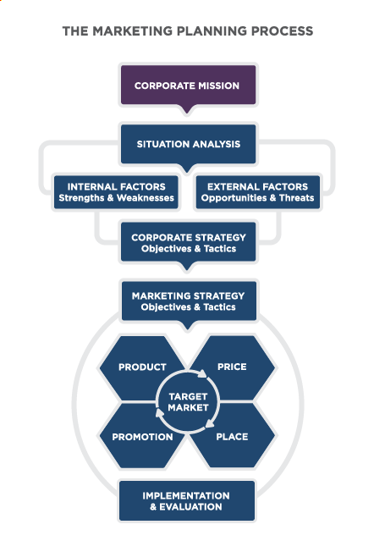
Mission Statement
The mission statement explains why an organization exists
Notes:
The Mission Statement. Provided by: Lumen Learning. License: CC BY: Attribution

Slide 9

Effective Objectives are:
Specific
Measurable
Have a time frame
Notes:
Climbing. Authored by: Marcus Hansson. Located at: https://www.flickr.com/photos/marcus_hansson/14659581920/. License: CC BY: Attribution

Slide 10
Aligning Annual Company and Marketing Objectives: Example 1
Company Objective: Increase profitability by 6% over prior year
Marketing Objective: Increase the average selling price of the product from $186 to $198
Marketing Objective: Complete end-of-life process for three products with profit margins below 3%
Marketing Objective: Increase sales of star product 30% over prior year

Slide 11
Aligning Annual Company and Marketing Objectives: Example 2
Company Objective: Increase market share in one key market by 4%
Marketing Objective: Implement a competitive-positioning campaign relative to a key competitor
Marketing Objective: Introduce two new products to market
Marketing Objective: Introduce major enhancements in two product lines
Marketing Objective: Bring two new distribution partners on board to expand coverage to new major markets

Slide 12
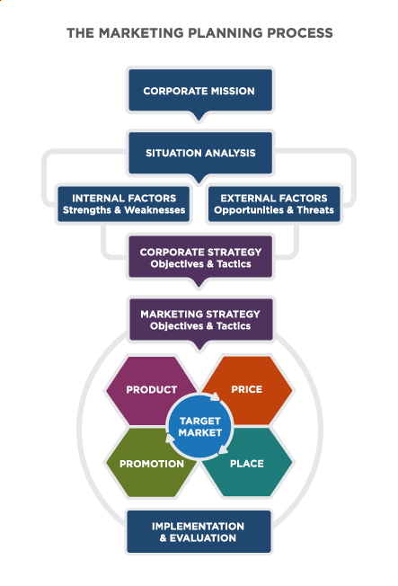
Marketing Planning Process

Slide 13

Implementation and Budget
Implementation involves the tactics used to execute the strategy
The implementation process emphasizes the timely completion of tasks
The marketing budget represents a plan to allocate expenditures to each of the components of the marketing mix
Notes:
Airport Traveler. Authored by: Nick Harris. Located at: https://www.flickr.com/photos/nickharris1/7004114708/. License: CC BY-ND: Attribution-NoDerivatives

Slide 14

Return on Marketing Investment
What were the goals of the campaign?
How did the target customer influence the campaign and the goals?
Was it successful?
What metrics were used to determine the success of the campaign?
Notes:
Graveyard Lemonade Stand. Authored by: Nina Frazier. Located at: https://www.flickr.com/photos/ninajeaninephotography/2802597662/. License: CC BY-SA: Attribution-ShareAlike

Slide 15
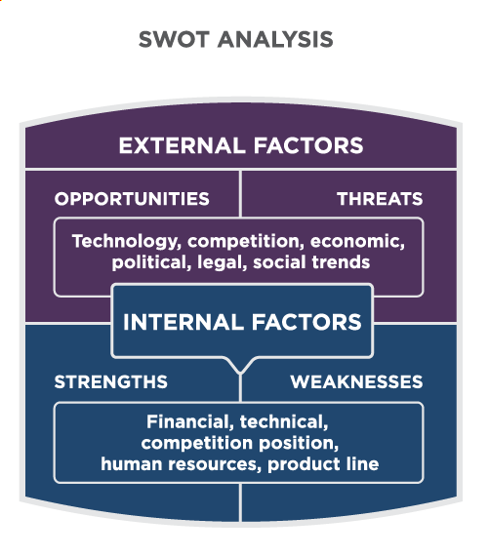
SWOT Analysis
Notes:
SWOT Analysis. Provided by: Lumen Learning. License: CC BY: Attribution

Slide 16
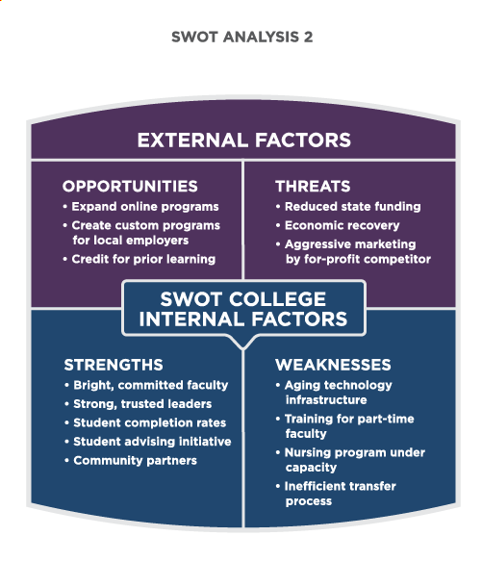
SWOT Example For A College
Notes:
SWOT Analysis. Provided by: Lumen Learning. License: CC BY: Attribution

Slide 17
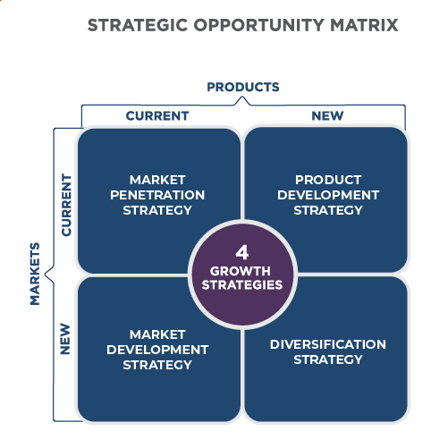
Strategic Opportunity Matrix
Notes:
Strategies and Risks. Authored by: Lumen Learning. License: CC BY: Attribution

Slide 18
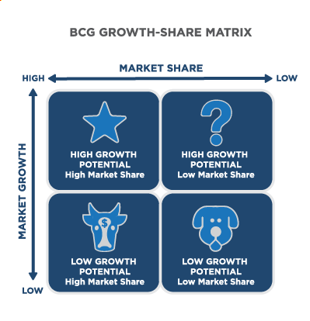
BCG Growth-Share Matrix
Notes:
Market Share and Market Growth Potential. Provided by: Lumen Learning. License: CC BY: Attribution

Slide 19
Growth Strategies
Each strategy entails a different level of risk
Market penetration
Market development
Product development
Diversification

Slide 20
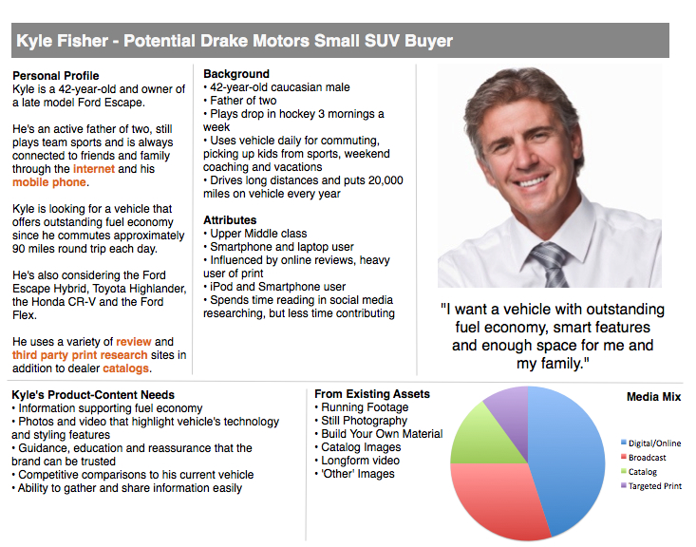
Buyer Personas
Notes:
Sample User Persona Drake Motors Ltd. Authored by: Daniel Eizans. Located at: https://www.flickr.com/photos/deizans/5525707263. License: CC BY-NC-ND: Attribution-NonCommercial-NoDerivatives

Slide 21
What is a Buyer Persona?
Fictional, generalized representations of an ideal customer that help a marketer understand current and potential customers better

Slide 22
Customer Relationships Management
A discipline in marketing combining database and computer technology with customer service and marketing communications
Customer relationship management seeks to create more meaningful one-on-one communications with the customer by applying customer data (demographic, industry, buying history, etc.) to every communications vehicle

Slide 23
Practice Question
Barbecue blends wants to sell their line of spice rubs in China. What growth strategy is this?
Notes:
Market Development

Slide 24
Quick Review
How do marketing strategies align with corporate strategies?
What are the inputs and components of a marketing strategy?
How are common analytic tools used to inform the organization’s strategy?
What are some examples of corporate strategies?
How are the development and maintenance of customer relationships an essential part of an organization’s marketing strategy?

