Slide 1
Principles of Marketing
Module 2: Marketing Function
Notes:
All text in these slides is taken from https://courses.lumenlearning.com/wmopen-principlesofmarketing/, where it is published under one or more open licenses.
All images in these slides are attributed in the notes of the slide on which they appear and licensed as indicated.
Cover Image: "Shopping freak." Provided by: freestocks.org. Located at: https://unsplash.com/photos/_3Q3tsJ01nc. Content Type: CC Licensed Content, Shared Previously. License: CC0: No Rights Reserved.

Slide 2
Marketing Orientation
Companies with a marketing orientation focus on identifying and understanding the customer’s needs and wants and addressing them more effectively or efficiently than one’s competitors

Slide 3

Why Do Customers Matter in Marketing?
Marketing exists to help organizations understand, reach, and deliver value to their customers
The customer is considered the cornerstone of marketing
Notes:
OOL. Authored by: Christian Rivera. Located at: https://www.flickr.com/photos/sevenfloorsdown/4543508614/. License: CC BY-NC-ND: Attribution-NonCommercial-NoDerivatives

Slide 4
Segmentation and Targeting
Segmentation is the process of dividing potential customers into groups to better understand them
Targeting is determining which segments are most likely to become customers and directing marketing efforts to best to satisfy them

Slide 5
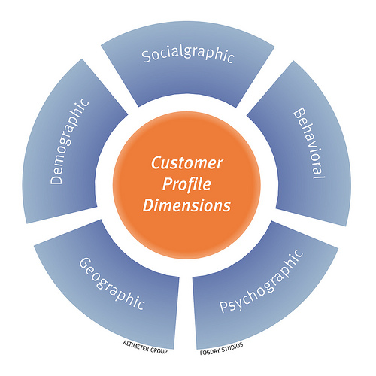
Defining a Target Market
Identify the business need you address
Segment your total market
Profile your target customer segment(s)
Research and validate your market opportunity
Notes:
Customer Profile Dimensions. Authored by: fogfish. Located at: https://www.flickr.com/photos/fogfish/4404316225. License: CC BY-SA: Attribution-ShareAlike

Slide 6
Value for the Customer
Value = benefit – cost
Price is only part of cost
Customers will consider competitors and substitutes
Differentiation is how marketers optimize the elements of a product that provide unique value to customers
When a company can create greater value for customers than its competitors, it has a competitive advantage

Slide 7

Value Proposition
A value proposition provides a very simple answer to the question: Why should someone buy what you are offering?
The value proposition should be clear, compelling, and differentiating
Notes:
Apples--Stand Out. Authored by: Flazingo Photos. Located at: https://www.flickr.com/photos/124247024@N07/14086869112/. License: CC BY-SA: Attribution-ShareAlike

Slide 8
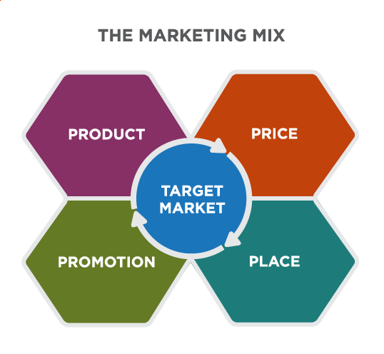
The Marketing Mix
Notes:
Defining the Marketing Mix. Provided by: Lumen Learning. License: CC BY-SA: Attribution-ShareAlike

Slide 9
Evolving Definitions of the Marketing Mix
4 Ps
4 Cs
Product
Price
Promotion
Place
Consumer solution
Cost
Communication
Convenience
Notes:
Adapted from 4 Ps and 4 Cs chart. Provided by: Wikipedia. Located at: https://en.m.wikipedia.org/wiki/Marketing_mix#Lauterborn.27s_four_Cs. License: CC BY-SA: Attribution-ShareAlike

Slide 10
Product vs Customer Solution
A company will only sell what the consumer specifically wants to buy. So, marketers should study consumer wants and needs to attract them.
Notes:
Adapted from 4 Ps and 4 Cs chart. Provided by: Wikipedia. Located at: https://en.m.wikipedia.org/wiki/Marketing_mix#Lauterborn.27s_four_Cs. License: CC BY-SA: Attribution-ShareAlike

Slide 11
Price vs Cost
Price is only a part of the total cost to satisfy a want or a need. For example, the total cost might be the cost of time in acquiring a good or a service, along with the cost of conscience in consuming it. It reflects the total cost of ownership. Many factors affect cost, including but not limited to the customer’s cost to change or implement the new product or service and the customer’s cost for not selecting a competitor’s product or service.
Notes:
Adapted from 4 Ps and 4 Cs chart. Provided by: Wikipedia. Located at: https://en.m.wikipedia.org/wiki/Marketing_mix#Lauterborn.27s_four_Cs. License: CC BY-SA: Attribution-ShareAlike

Slide 12
Promotion vs Communication
Communications can include advertising, public relations, personal selling, viral advertising, and any form of communication between the organization and the consumer.
Notes:
Adapted from 4 Ps and 4 Cs chart. Provided by: Wikipedia. Located at: https://en.m.wikipedia.org/wiki/Marketing_mix#Lauterborn.27s_four_Cs. License: CC BY-SA: Attribution-ShareAlike

Slide 13
Place vs Convenience
Marketers should know how the target market prefers to buy, how to be there and be ubiquitous, in order to provide convenience of buying. With the rise of Internet and hybrid models of purchasing, “place” is becoming less relevant. Convenience takes into account the ease of buying the product, finding the product, and finding information about the product.
Notes:
Adapted from 4 Ps and 4 Cs chart. Provided by: Wikipedia. Located at: https://en.m.wikipedia.org/wiki/Marketing_mix#Lauterborn.27s_four_Cs. License: CC BY-SA: Attribution-ShareAlike

Slide 14
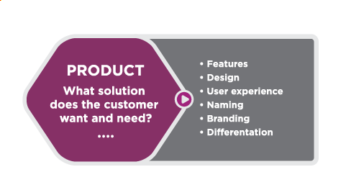
Product

Slide 15
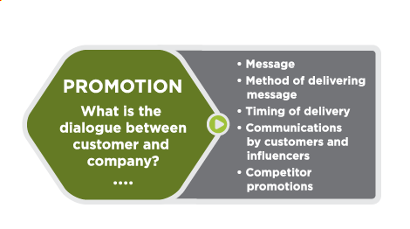
Promotion

Slide 16
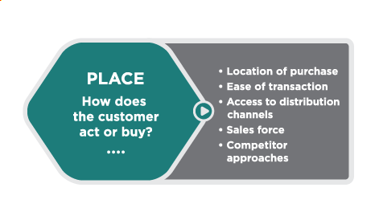
Place

Slide 17
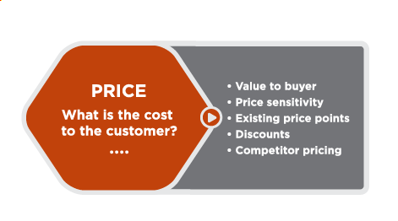
Price

Slide 18
Marketing Plan
The marketing plan describes how the company will use the marketing mix—product, promotion, place, and price—to achieve its marketing objectives effectively within the competitive market environment

Slide 19
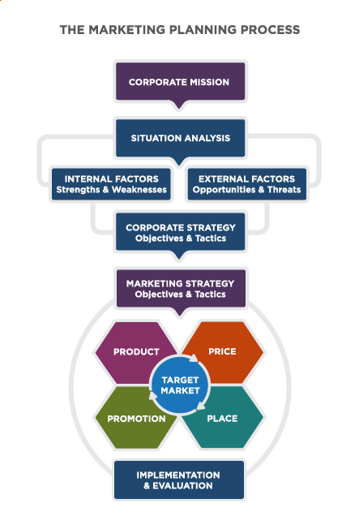
The Marketing Planning Process

Slide 20
Class Activity: Match the Marketing Mix Below to a Market Segment
Marketing Mix
Market Segment
Exceptionally Soft Cashmere blankets $89.99
Buy in store or order online for two day free delivery. Free returns. Excellent customer service.
Samples sent to lifestyle bloggers, ads in home magazines
Parents of newborns
Women aged 40-55
Boys 14-17

Slide 21
Quick Review
Why is the customer the cornerstone of marketing?
What are segmentation and targeting?
What is the marketing mix?
How do organizations use the marketing mix (often called the four Ps) to market to their target customers?
What is the role of a marketing plan in guiding marketing activities?

