Slide 1
Principles of Marketing
Module 1: What Is Marketing?
Notes:
All text in these slides is taken from https://courses.lumenlearning.com/wmopen-principlesofmarketing/, where it is published under one or more open licenses.
All images in these slides are attributed in the notes of the slide on which they appear and licensed as indicated.
Cover Image: "Shopping freak." Provided by: freestocks.org. Located at: https://unsplash.com/photos/_3Q3tsJ01nc. Content Type: CC Licensed Content, Shared Previously. License: CC0: No Rights Reserved.

Slide 2
What is Marketing?
Marketing is a set of activities related to creating, communicating, delivering, and exchanging offerings that have value for others

Slide 3
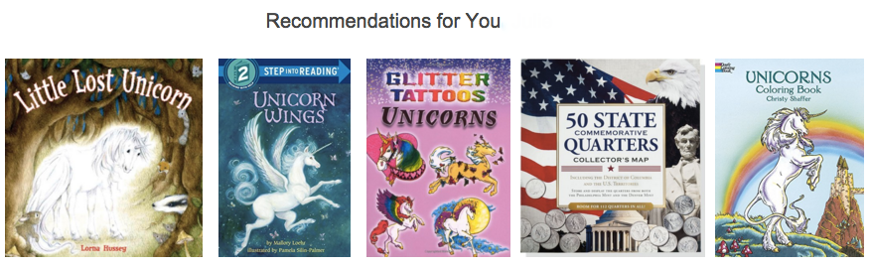
What is the function of marketing?
Marketing brings value to customers, whom the business seeks to identify, satisfy, and retain.
Notes:
Screen shot of Amazon unicorn recommendations. Provided by: Amazon. License: All Rights Reserved. License Terms: Fair Use

Slide 4
The Exchange Process
The act of obtaining a desired object from someone by offering something of value in return
  Customer (or buyer)
  Product
  Provider (or seller)
  Transaction

Slide 5
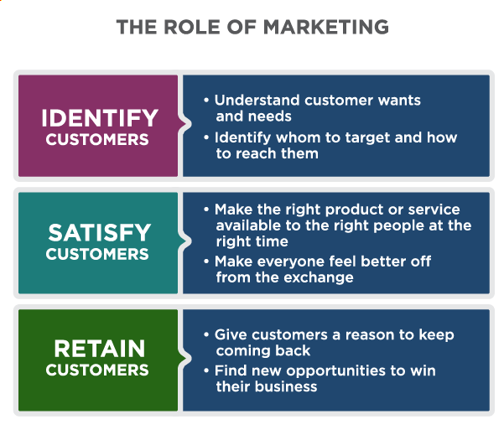
The Role of Marketing
Notes:
What Is Marketing?, Marketing Creates Value for Customers. Authored by: Lumen Learning. License: CC BY: Attribution

Slide 6
Marketing vs. Advertising
Advertising uses paid notices in different forms of media to draw public attention to a company, product, or message, usually for the purpose of selling products or services [1]
Advertising is one of many tools marketers use
Notes:
[1] "Advertising." The Free Dictionary. Accessed September 10, 2019. http://www.thefreedictionary.com/advertising

Slide 7
Marketing vs. Branding
Branding is the process of “creating a unique name and image for a product in the consumer’s mind” ^{[1]}
Marketing builds brands, and branding is an important strategic consideration in marketing, but marketing is broader than branding
Notes:
[1] "Branding." Business Dictionary. Accessed September 10, 2019. http://www.businessdictionary.com/definition/branding.html

Slide 8
Marketing vs. Sales
Sales is the process of actually selling products or services
Effective marketing aligns well with the sales process and leads to increased sales, but there is more to marketing than just supporting sales

Slide 9
Company Orientations
The Marketing Concept
  Success depends on doing better than competitors at understanding, creating, delivering, and communicating value to their target customers
The Product Concept
  Success depends on creating the best, most innovative product for the lowest price
The Sales Concept
  Success depends on a good sales team with the right tools and incentives.
The Production Concept
  Success depends on low production costs, highly efficient processes, and mass distribution.
Notes:
The Marketing Concept
Success depends on doing better than competitors at understanding, creating, delivering, and communicating value to their target customers
The Product Concept
Success depends on creating the best, most innovative product for the lowest price
The Sales Concept
Success depends on a good sales team with the right tools and incentives.
The Production Concept
Success depends on low production costs, highly efficient processes, and mass distribution.

Slide 10
Relationship Stages
Meeting and Getting Acquainted
Providing a Satisfying Experience
Sustaining a Committed Relationship

Slide 11
Stage 1: Meeting and Getting Acquainted
Find desirable target customers, including those likely to deliver a high customer lifetime value
Understand what these customers want
Build awareness and demand for what you offer
Capture new business

Slide 12
Stage 2: Providing a Satisfying Experience
Measure and improve customer satisfaction
Track how customers’ needs and wants evolve
Develop customer confidence, trust, and goodwill
Demonstrate and communicate competitive advantage
Monitor and counter competitive forces

Slide 13
Stage 3: Sustaining a Committed Relationship
Convert contacts into loyal repeat customers, rather than one-time customers
Anticipate and respond to evolving needs
Deepen relationships, expand reach of and reliance on what you offer

Slide 14

What is Customer Lifetime Value?
Customer lifetime value predicts how much profit the company will make from the customer during his or her lifetime relationship with the company ^{[1]}
Notes:
Lady on a Staircase. Authored by: torbakhopper. Located at: https://www.flickr.com/photos/gazeronly/10147130996/. License: CC BY-ND: Attribution-NoDerivatives
[1] "Customer Lifetime Value." Cambridge Dictionary. Accessed September 10, 2019. http://dictionary.cambridge.org/us/dictionary/english/customer-lifetime-value

Slide 15
How Do Strong Customer Relationships Help a Business?
Happy customers . . .
  Return to buy more goods and services
  Help market the business with positive reviews or word of mouth
  Engage with the brand

Slide 16
Goals of Marketing
For profit companies
Not for profit organizations
Increase profits by selling products or services to customers
Promote the mission by attracting donors or participants or by raising awareness of an issue or cause

Slide 17
Difference Between Customers and Consumers
Customers are the individuals who buy the product
Consumers are the individuals who actually use the product
The customer and the consumer are not always the same
Example: A food distributor’s customer is the restaurant, not the diner who is the consumer

Slide 18
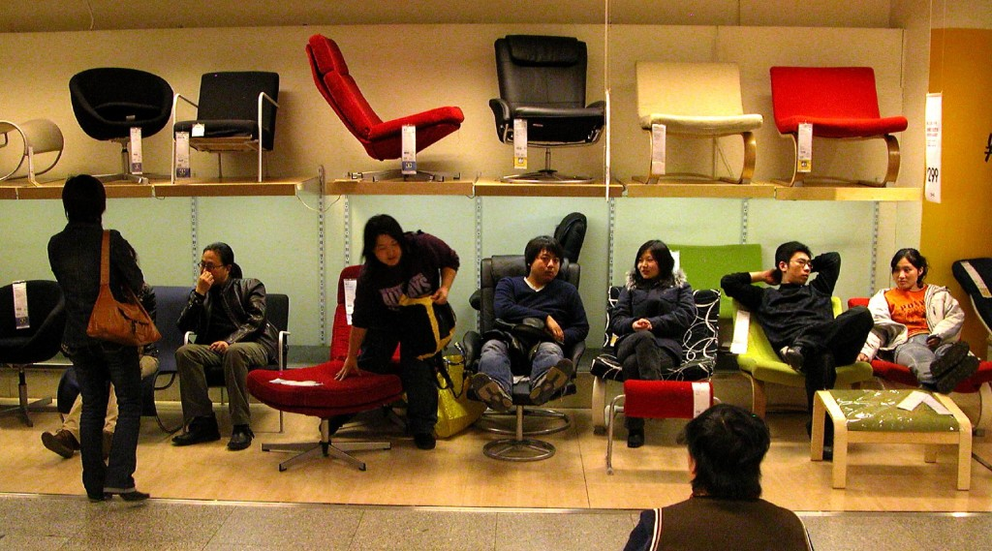
B2B vs. B2C
B2B or Business to Business companies sell products or services to other businesses
B2C or Business to Consumer companies sell directly to consumers
Notes:
IKEA, Bejing. Authored by: Peter Morgan. Located at: https://www.flickr.com/photos/pmorgan/5517848/. License: CC BY-NC-ND: Attribution-NonCommercial-NoDerivatives

Slide 19
Practice Question 1
A B2B business would benefit most from
  Television advertisement
  Trade show
  Presentation at the rotary club

Slide 20
Practice Question 2
A B2C business would benefit most from
  Television advertisement
  Trade show
  Presentation at the rotary club

Slide 21
Practice Question 3
A Dual focus business would benefit most from
  Television advertisement
  Trade show
  Presentation at the rotary club

Slide 22
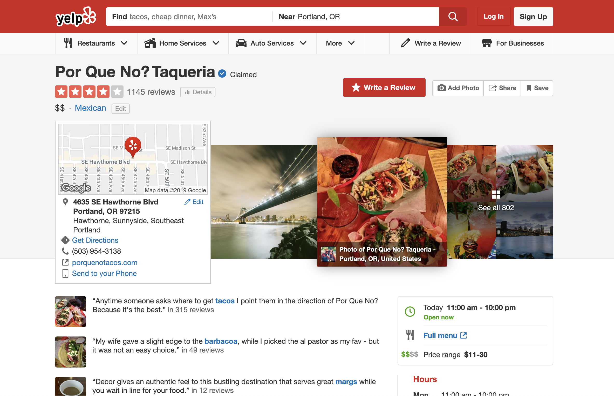
How does Marketing Serve Customers?
Marketing can help customers find goods and services that are valuable to them
Notes:
Screen Shot of Yelp Review. Authored by: Yelp.com. Located at: https://www.yelp.com/biz/por-que-no-taqueria-portland. License: All Rights Reserved. License Terms: Fair Use

Slide 23
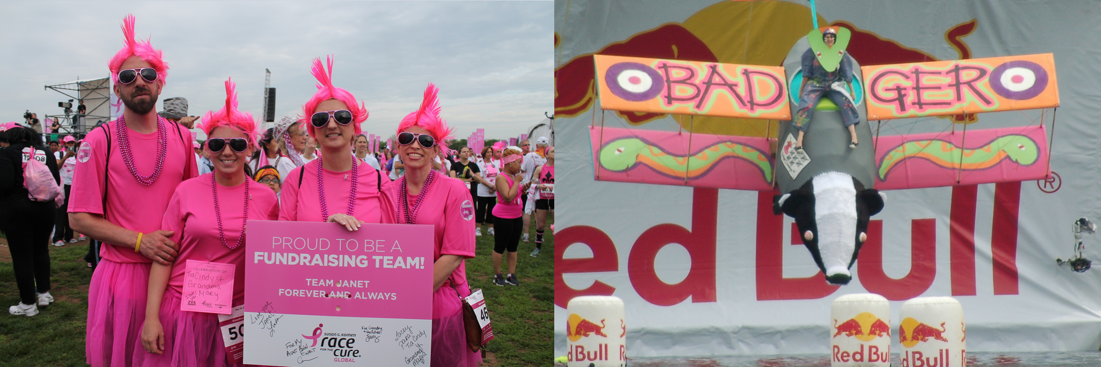
How Does Marketing Serve Society?
Marketing helps customers and businesses find each other to make exchanges that benefit them both
Marketing can spread ideas and innovation
Notes:
Global Race for the Cure. Authored by: Elvert Barnes. Located at: https://www.flickr.com/photos/perspective/13987275038/. License: CC BY-SA: Attribution-ShareAlike
Flugtag (22). Authored by: Helen Crook. Located at: https://www.flickr.com/photos/lalalen/2565923132/. License: CC BY-NC-ND: Attribution-NonCommercial-NoDerivatives

Slide 24
Quick Review
What is marketing?
Where do you experience marketing in everyday life?
What are the differences between marketing, branding, advertising, and sales?
What is the marketing concept? How does it differ from the production concept, the product concept, or the selling concept?

Slide 25
More Quick Review
What is the role of marketing in building and managing customer relationships?
How do different types of organizations, such as non-profits, consumer product (B2C) firms and business-to-business (B2B) organizations, use marketing?
How does marketing create value for the consumer, the company, and society?

